Slide 1
חקר מוצר ב'
עודד גיא

Slide 2
Assignment follow up

Slide 3
Product research
Product Research / niche research - bummer !
This is your Amazon Bootstrap - Be open to learn
One of the most important skills / knowledge to have as amazon seller - no shortcuts. (Some exceptions at the end….)
One of the most time consuming, low productivity tasks - But the business always needs to perform.
Once you master it - Delegate/Outsource most of the process - take the decisions.
Product Launch Pipeline / Brand Launch Pipeline = Growth Plan, Value.

Slide 4
FIND <> VALIDATE
There are many Ways to look at Product Research, however most of them will Have the following components, or steps:
Find Product Opportunities
VALIDATE

Slide 5
Soft initial criterias- reminder
Most sellers are FBA sellers
Without a dominant brand
Sell price - $20 - $80
Nice spread of revenues among products
FBA Tier size = Standard size
Product is not over-complex / breakable /
Seasonality change should not be over 50%
COGS to Price 1:4
Sales velocity - Can i compete in this sales volume?
4 months of inventory required - Starting capital

Slide 6
Potential product list
Make your own table and lists
Save screenshots and Review later – Holiday Season nowadays
Grow a big list with constant flow of new opportunities.
Opportunities are temporary - Time To Market

Slide 7
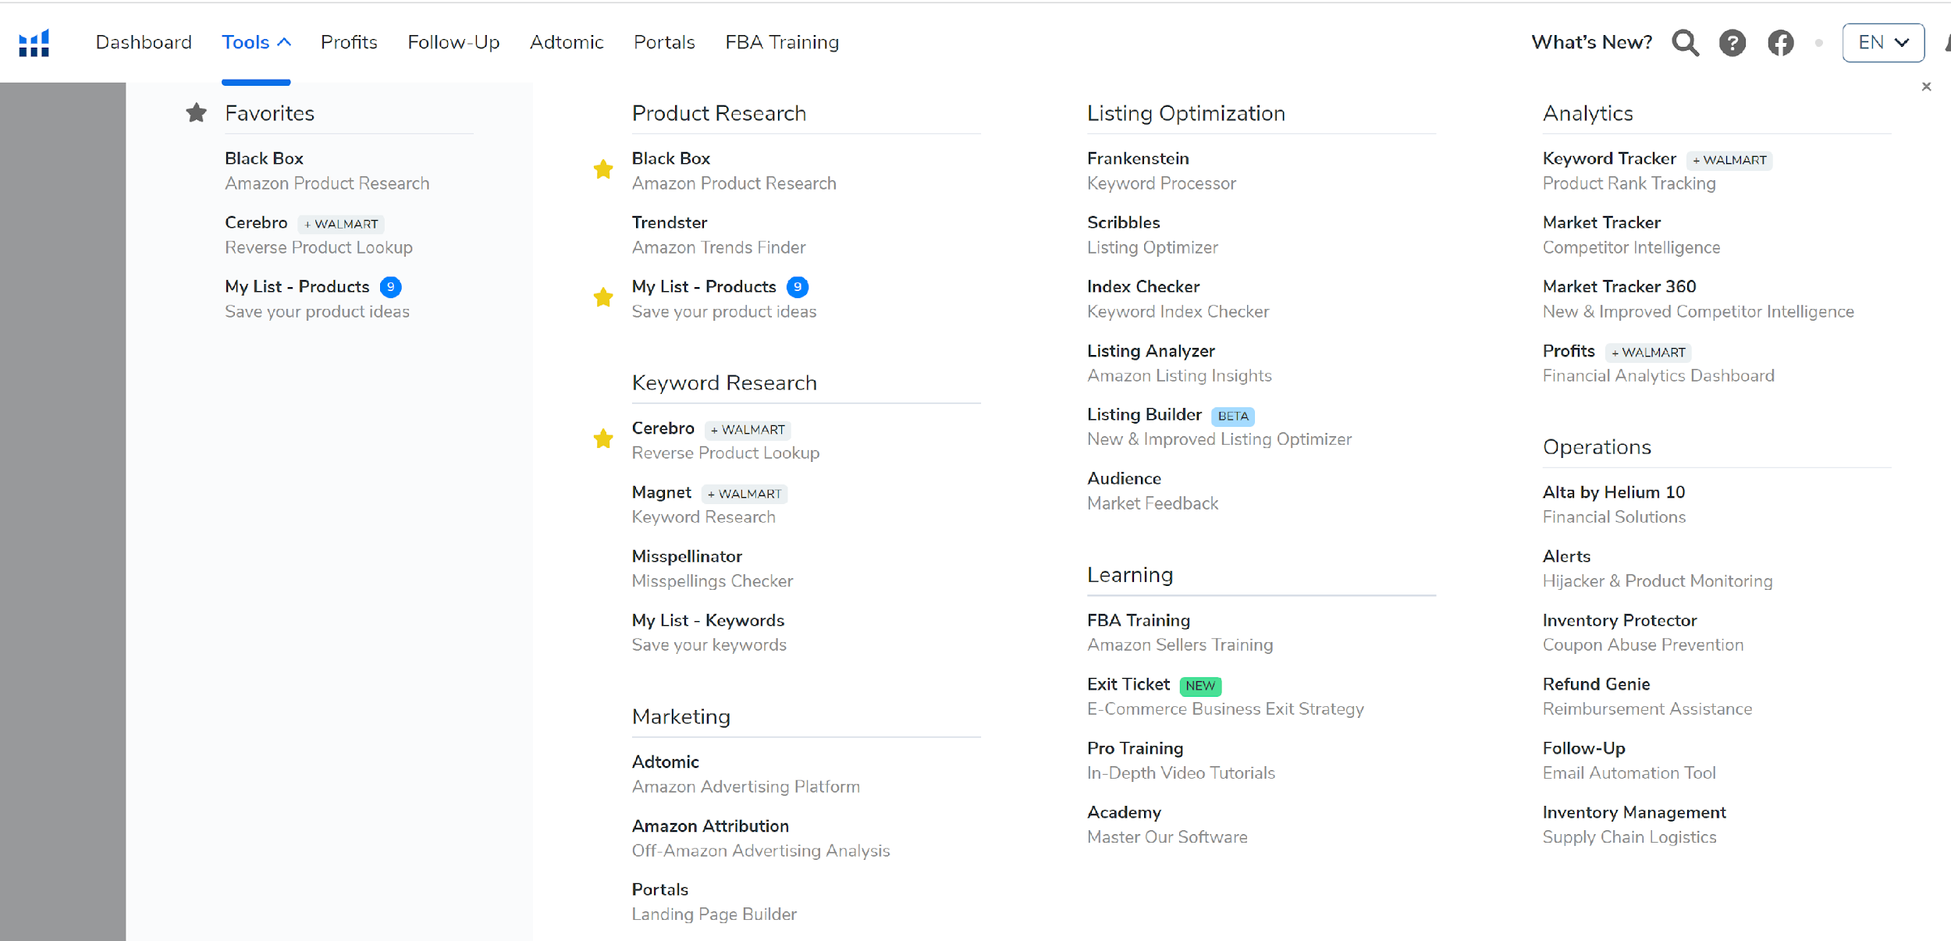
Helium 10 – Black Box

Slide 8
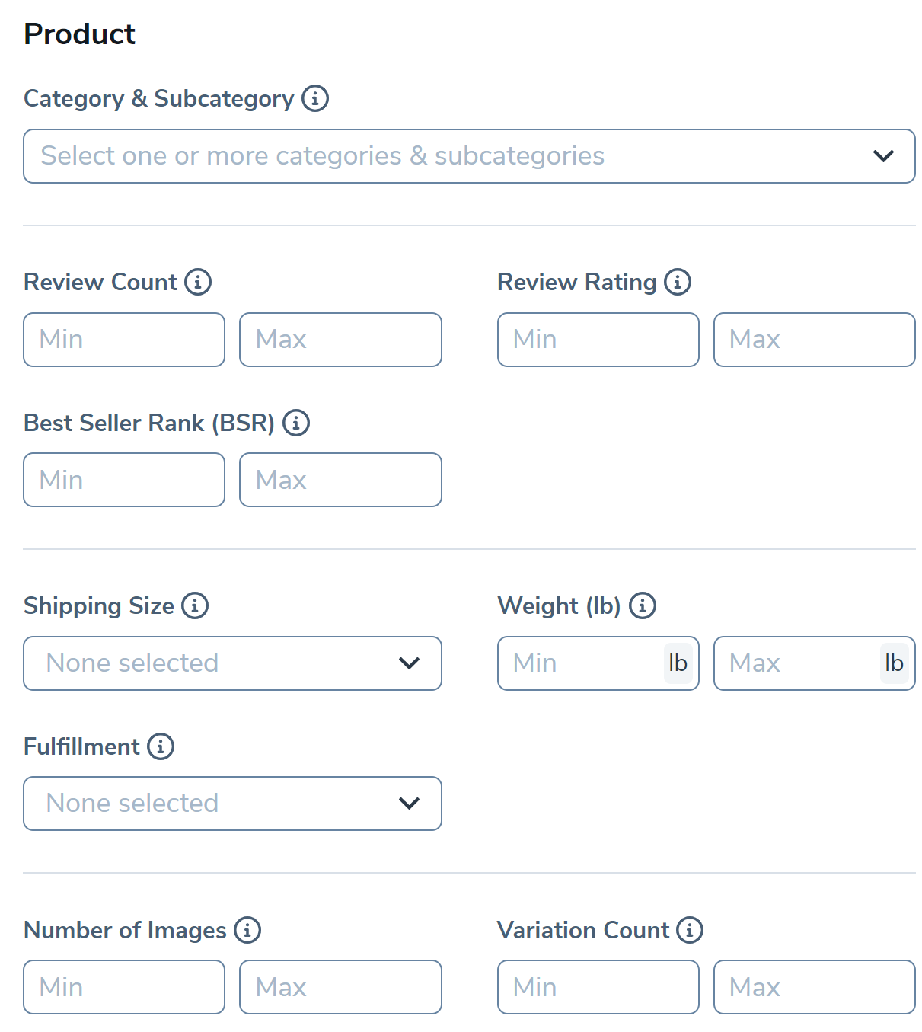
Helium 10 – Black Box
Black Box - Amazon Product Research
Black Box / All tools - LEARN Button
Search Product / Keyword / Niche
Generate results with your own criteria
Find an opportunity and go “down the rabbit hole”
Keep in your list / move on to the next one
50
Standard
4

Slide 9
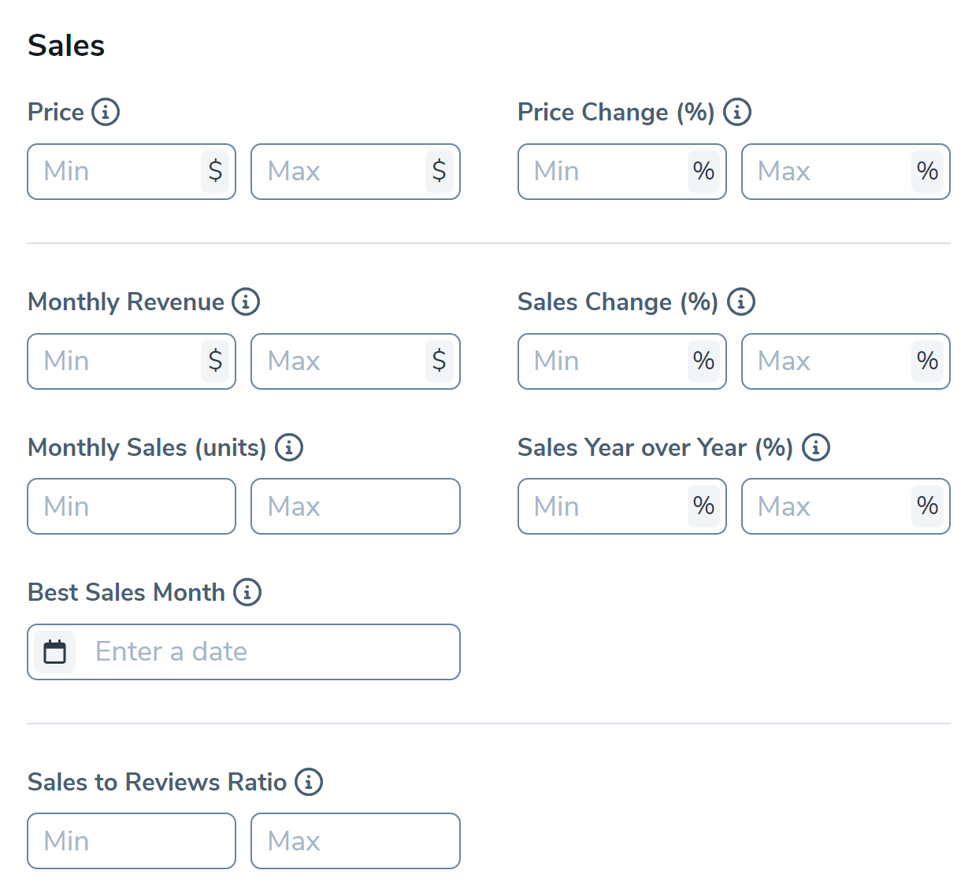
Helium 10 – Black Box

Slide 10
Product Hunting - Personal Preferences
Examples:
Car Sound Deadening Kit (250K monthly)
Garage Door Sensor (3M monthly)
Garage Bicycle hangers (850M monthly)
front seat organizer (750לK monthly)
Look into products you are somewhat related to
Understand the buyer needs, motives, pain points
The Friday Dinner Test - Unheard of Products
Surprise me with products I never heard of and
niches I never seen.
Thousands of unknown niches, sub-niches,
new product designs, new strong differentiator.

Slide 11
Terminology
FBA FEES
Seller central link (search anything on Google)
Small, oversize, and more 2-5$ (FBA SIZE TIERS)
Understand the structure
Know when you are on the edge
LEAD TIME
Manufacturing time + Shipping + Spare
1 month manufacturing + 1–2 month shipping (Depends on the route)
ROI (product research phase)
Costs / Net Profit
(Product + Shipping + Duties + FBA Fees + Referral Fees + PPC) / Net Profit
ROI Under 100% - Cannot grow without additional capital
ROI Over 200% - can grow exponentially, quickly get cash for another product

Slide 12
Knowing your Numbers !
Incomplete understanding of your numbers = business failure / Looses
What does it mean to know my numbers?
What does it take to know my numbers?
What will I gain by knowing my numbers?

Slide 13
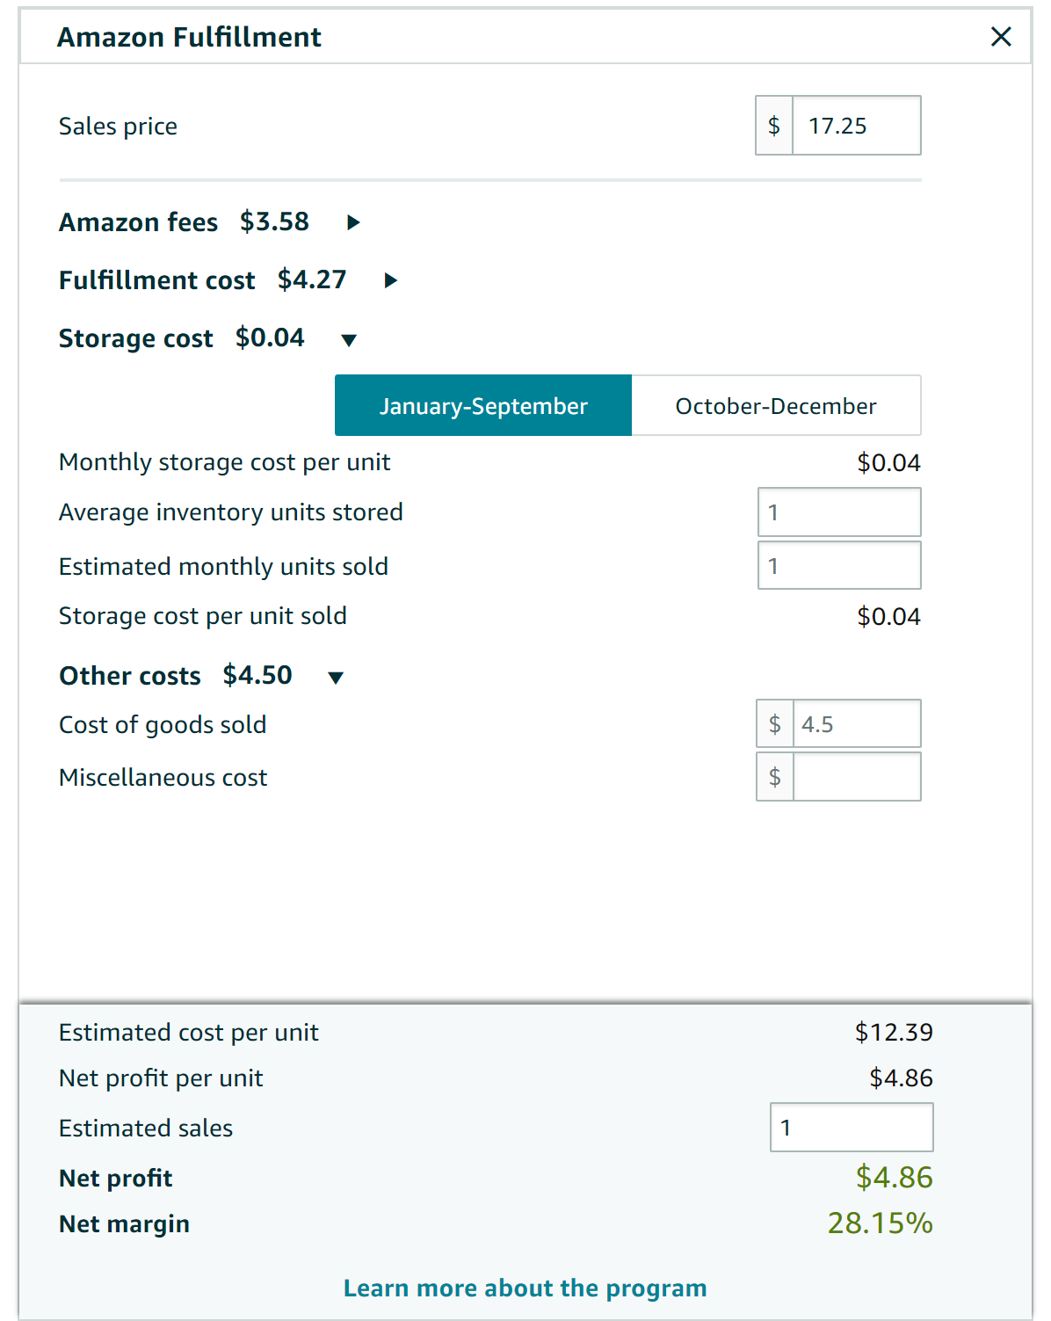
Amazon’s Revenue Calculator
Seller Central FBA Calculator (Alternative)
Many ALternatives Available Most will do the job just fine

Slide 14
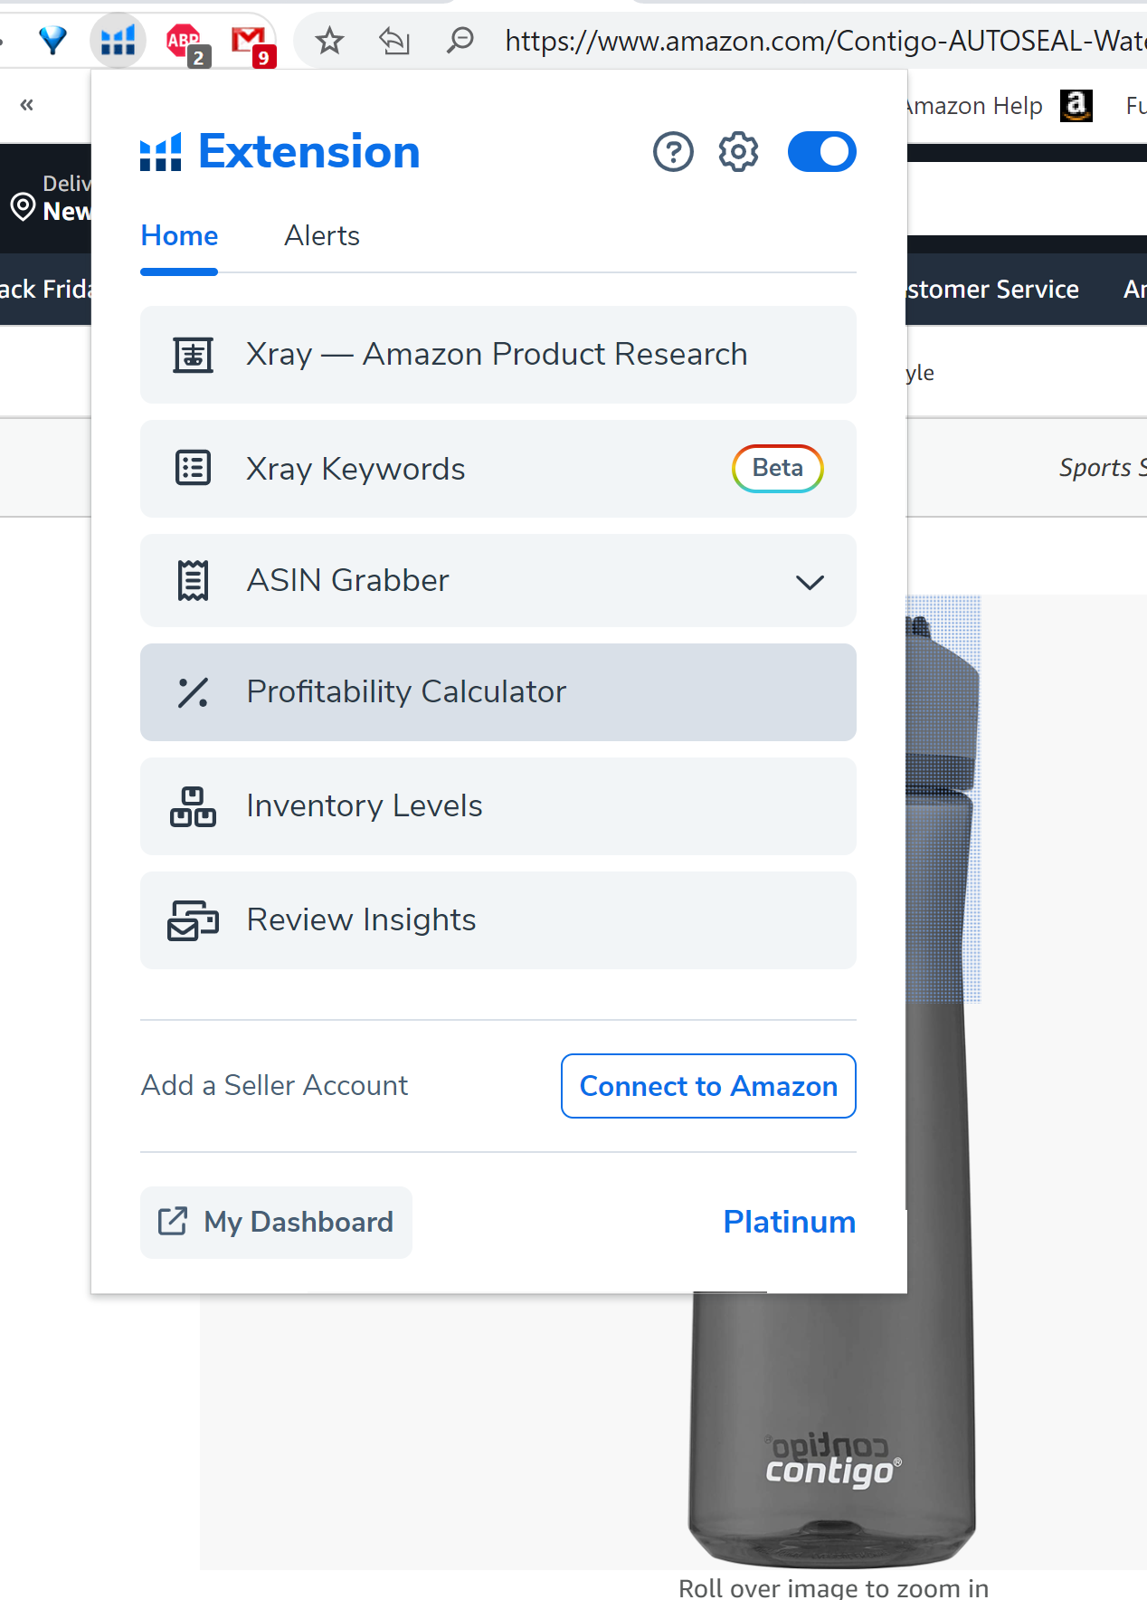
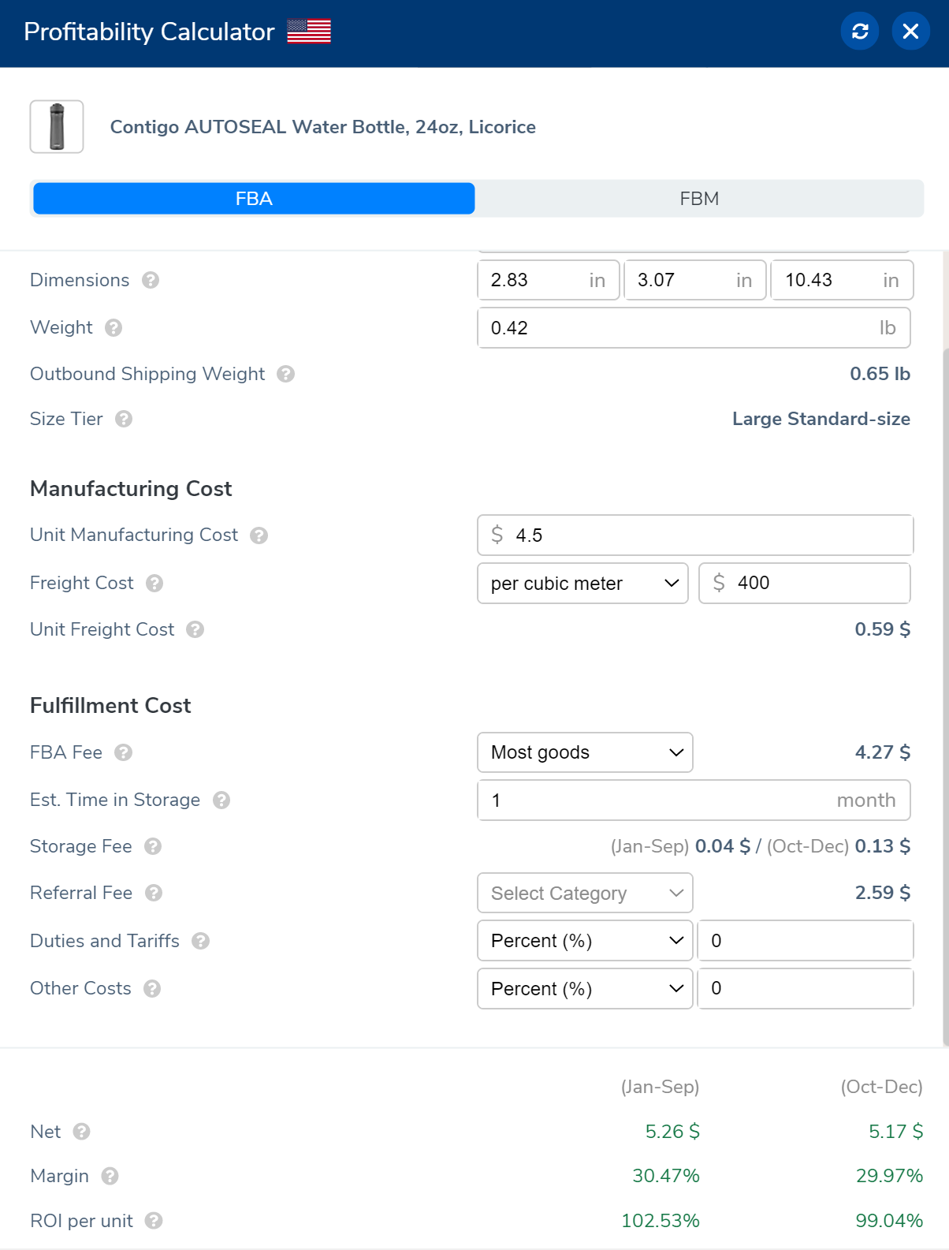
Helium 10 - Profitability Calculator
Price
Est Manufacturing cost (1:4)
Shipping cost
Other costs = 10% advertising
NET
MARGIN
ROI
live example

Slide 15
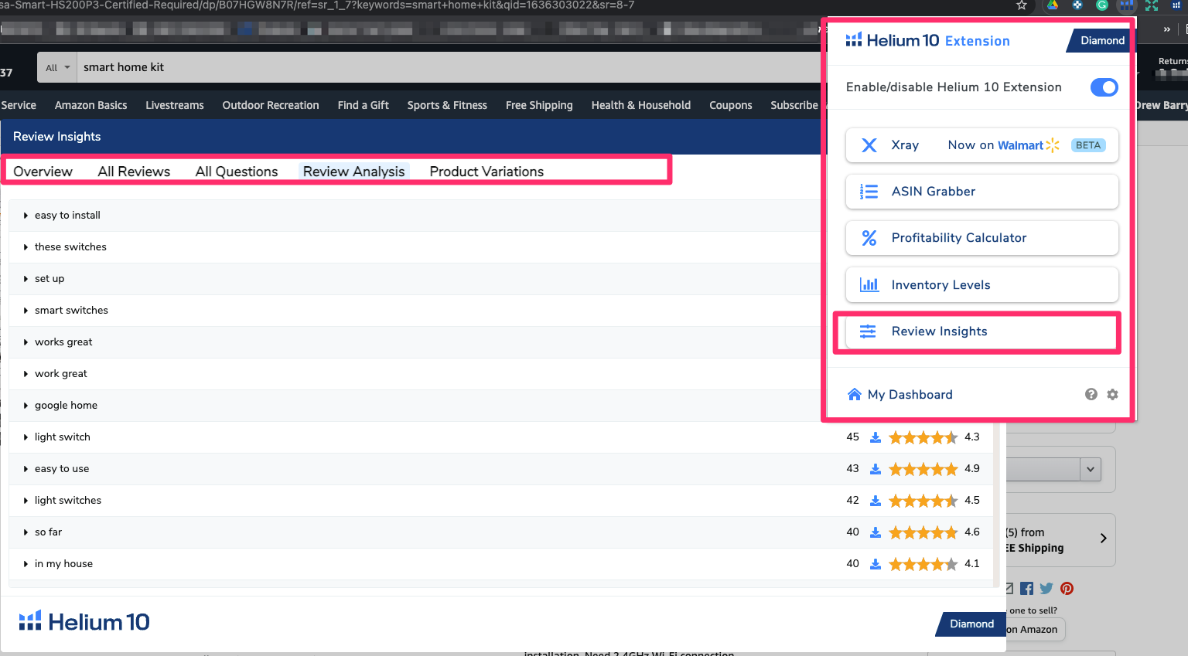
Helium 10 - Review Insights

Slide 16
Product Research - DIFFERENTIATION
DIFFERENTIATION!
Why will someone buy your product?
What will happen if tomorrow another seller launches the same product?
Perceived value vs actual value
Market segment targeting - Sub-Niche (for men / for women, High/low price)
Common Differentiations!
Different color / Size / Material
Different Design (same keyword, functionality / benefits) new models
Packaging (giftable, premium, usable, recycled, etc…)
Multipacks 3pack , 16pack, etc...
When you differentiae – you must show it on the listing!

Slide 17
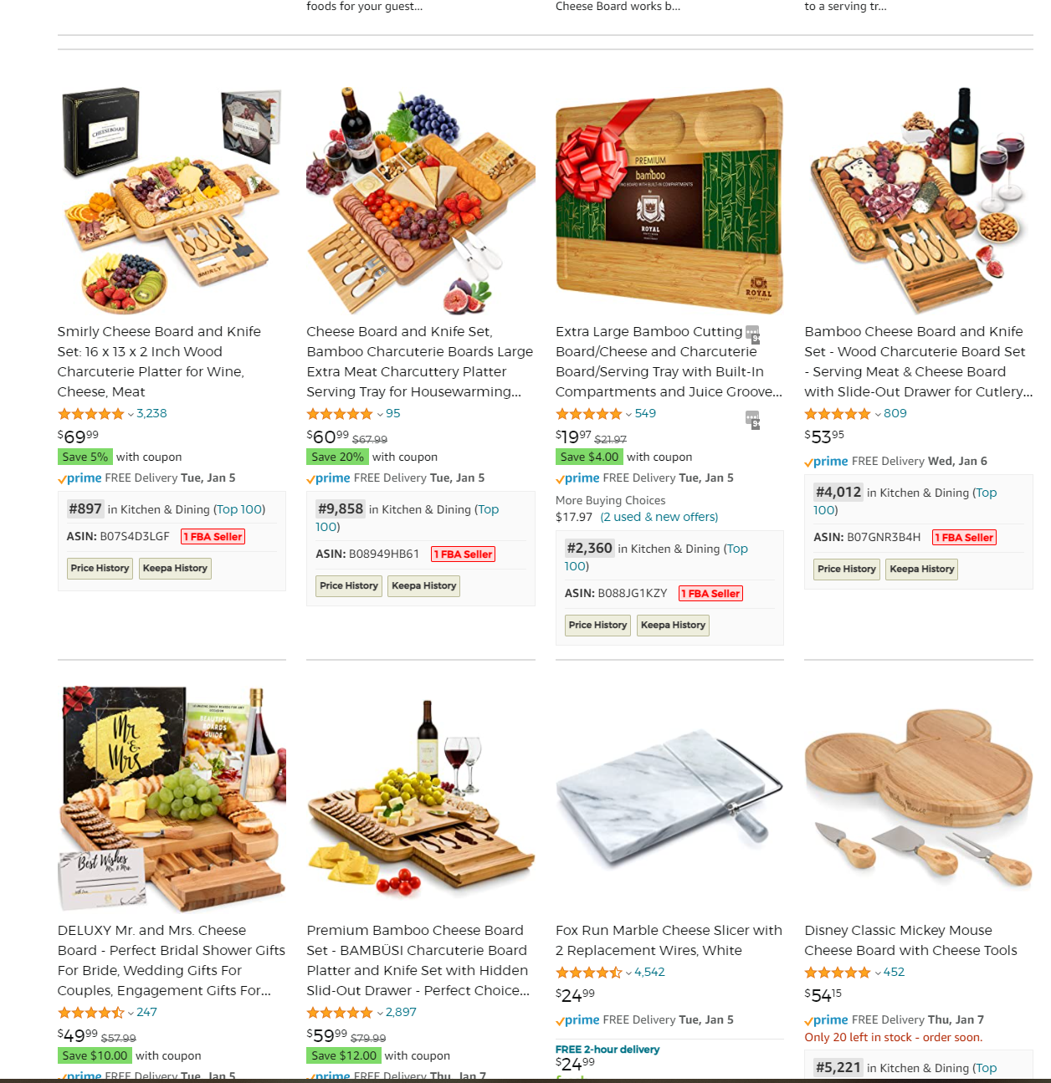
Differentiation - examples
Notes:
https://www.amazon.com/s?k=cheese+board&crid=35NYO17IPSB6A&sprefix=cheese%2Caps%2C324&ref=nb_sb_ss_ts-doa-p_3_6

Slide 18
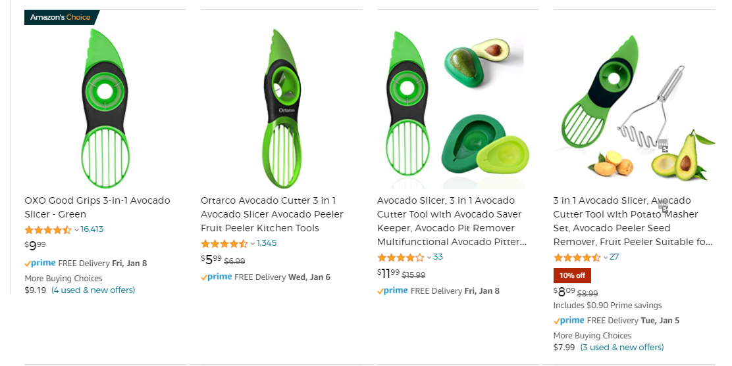
Differentiation - examples
Notes:
https://www.amazon.com/s?k=avocado+slicer&crid=1BBZJ2AJHAG7B&sprefix=avo%2Caps%2C372&ref=nb_sb_ss_ts-doa-p_4_3

Slide 19
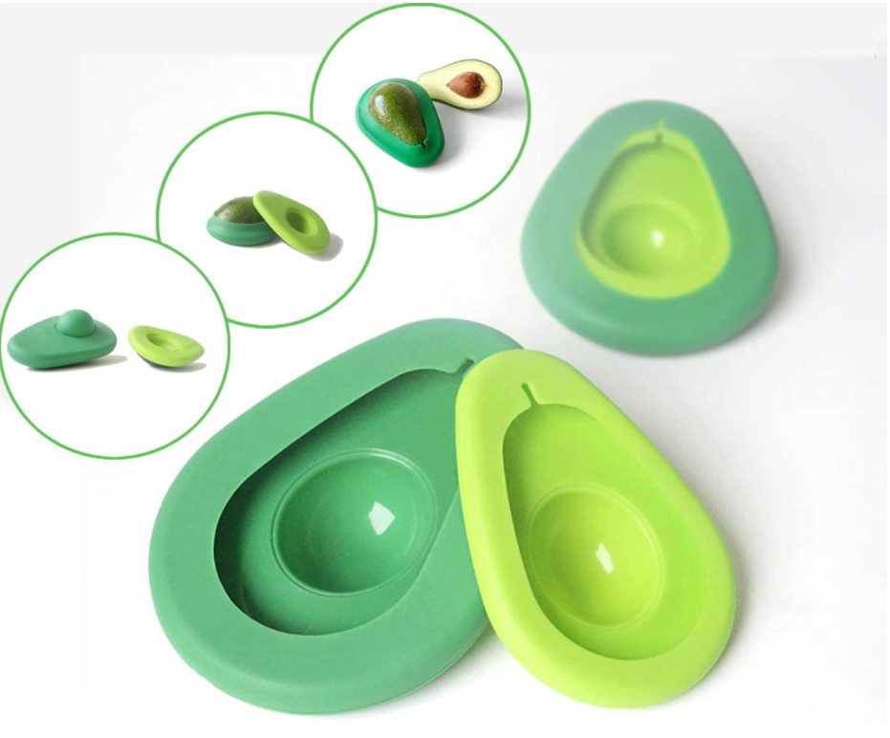
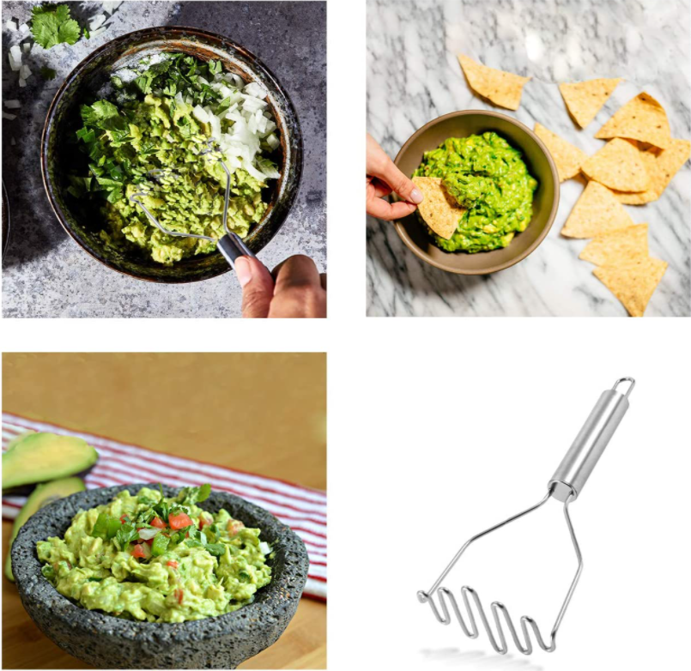
Differentiation - examples
Avocado keeper Avocado (Potato) smasher
Notes:
https://www.amazon.com/s?k=avocado+slicer&crid=1BBZJ2AJHAG7B&sprefix=avo%2Caps%2C372&ref=nb_sb_ss_ts-doa-p_4_3

Slide 20
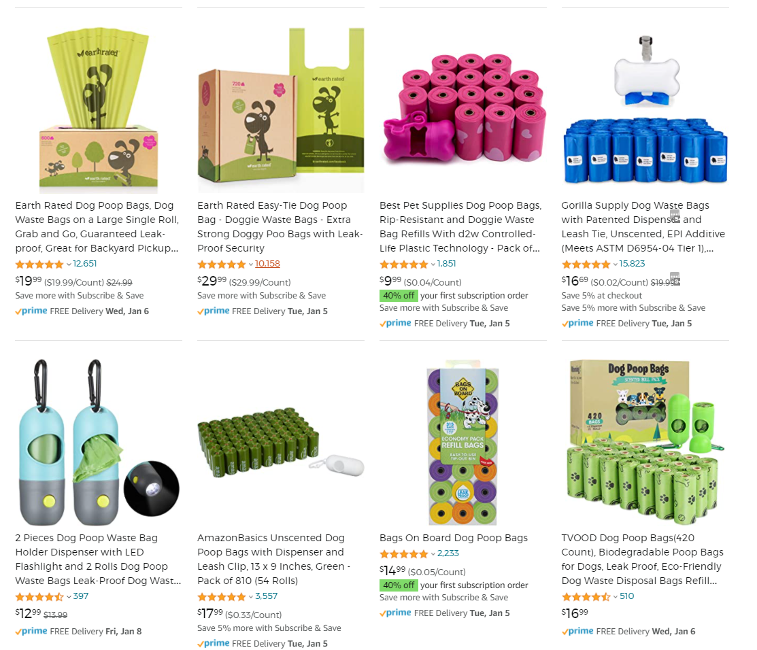
Differentiation - examples
Notes:
https://www.amazon.com/s?k=dog+poop+bags&rh=n%3A2975312011&ref=nb_sb_noss

Slide 21
Product Research - MOAT
MOAT!
Why do we want a moat?
Product Niches with Moats – beware
Common Moats!
Review Moat! (beware)
Patented Product or feature / Design Patent
Sourcing and Kitting from multiple sources
Licensing
High cost, Difficult Logistics, Difficult Compliance
Supplier from a different country

Slide 22
Product Research - Target Avatar
Know your Avatar
Gender, age, marital status, education, profession, socioeconomic status
What type of product are they buying online?
Fears and concerns
What drives them: passion purchase / get it done
Sources:
Reviews!
YouTube
Facebook Audience Insights
Common Sense

Slide 23
Product Research - Sub-Niche
Market segment targeting - Sub-Niche (for men / for women, High/low price)
Take a very big keyword / market and break it down
Find your own Sub-Nitche / Long term keyword that describes it
Work in the world of your sub-niche

Slide 24
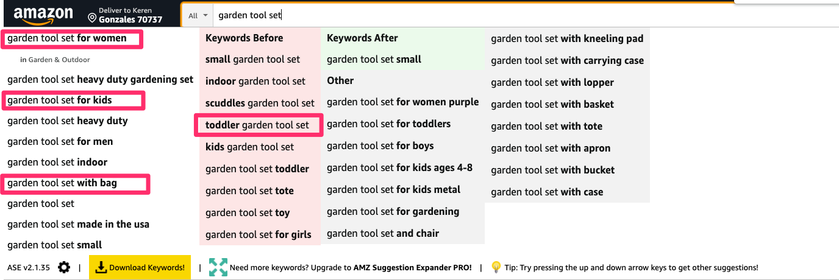
Product Research - Sub-Niche
CASE STUDY: Garden Tool Set

Slide 25
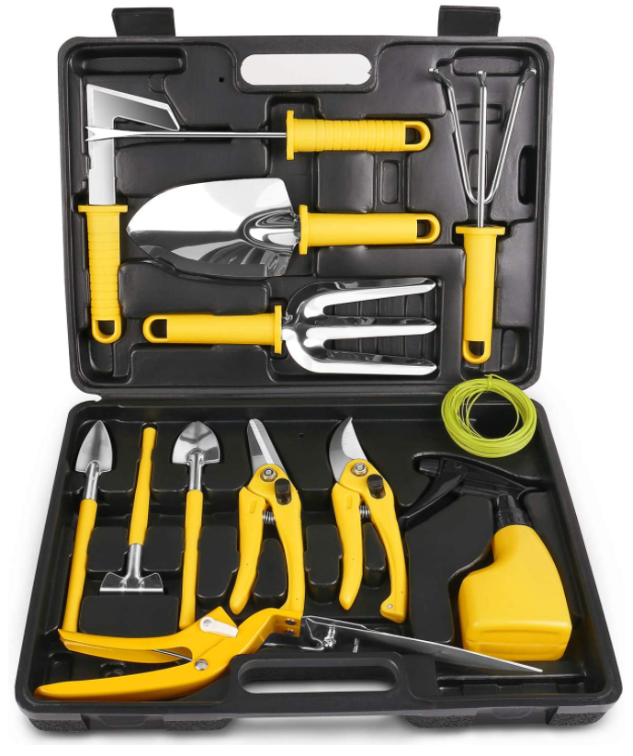
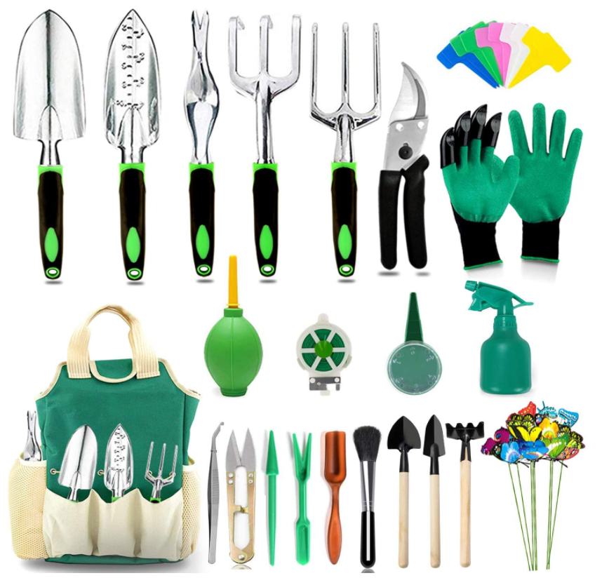
Garden tools set - Products types
With case
Bank for the buck

Slide 26
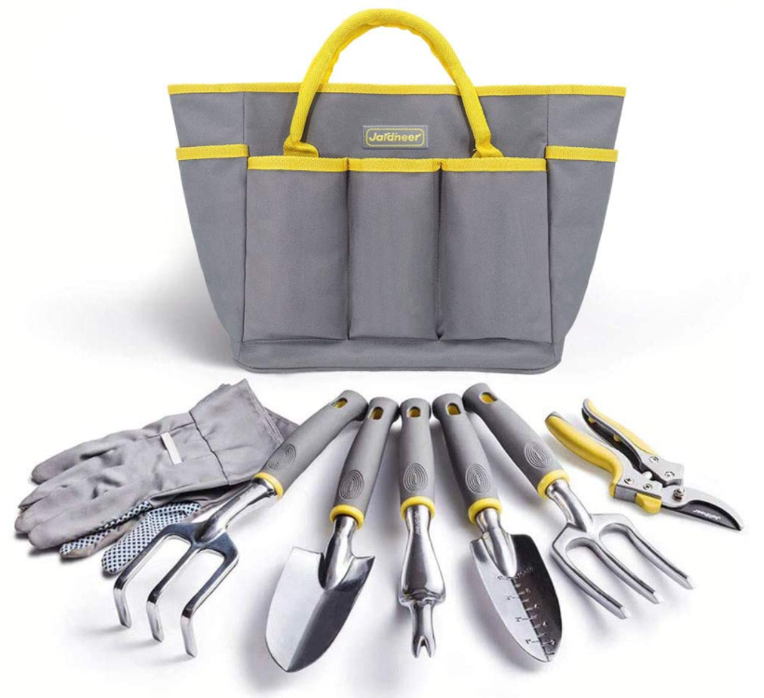
Garden tools set - Products types
“Normal”
High quality

Slide 27
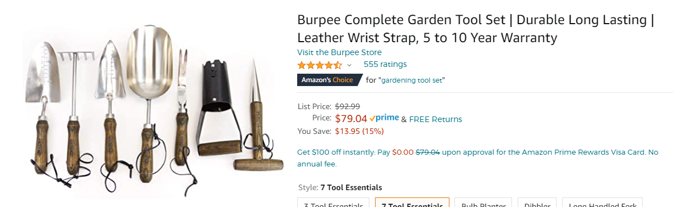
Garden tools set:
Materials

Slide 28
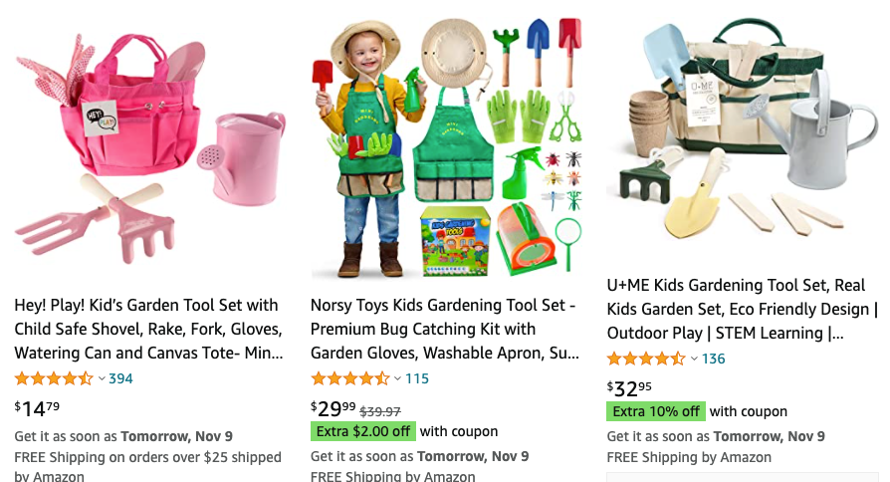
Garden Tool Set For kids (350K monthly searches)

Slide 29
Product Research - Workarounds
When you are advanced / When you just can't find ‘old school’ way….
Find a service that sells products for sellers
( https://www.demercadoservices.com/services )
Buy a small FBA business and Grow it big with more of the same ( https://empireflippers.com )
Hire Experienced VA’s for product research by your method or their method ( https://www.upwork.com )
Get Help from Friends and Family
Join another student/seller who has a product
Just keep looking…..

Slide 30
Home Assignments
WATCH AND LEARN - Helium 10 – Learn button
- Project X - Finding a product by keywords instead of Niche
CREATE your own version of spreadsheet, add data and more criteria's, checkpoints along the way - Share with others, learn from others.
SEARCH AND FIND - Fill out your spreadsheet with additional 15 fresh product opportunities - Good/No Good and why.

Slide 31
Thank You
www.negev-prime.com

