Slide 1
לוגיסטיקה וייצור – עידן כהן

Slide 2
Manufacturing and Supply Chain Orientation - why is this important
This is a key function in your amazon operations
This is one of the top 3 aspects a seller should focus on: (Product / PPC / Logistics)
In the Past 2 years the supply chain was a seller’s nightmare
Whoever was able to adjust and handle the changes - Stay in the Game and aften win.
Logistics considerations should be planned and thought about from the beginning of the product sourcing step.
We have many tools and resources to help us succeed.
עידן כהן| לוגיסטיקה וייצור

Slide 3
Manufacturing and Supply Chain Key aspects and considerations
Product Selection Considerations - Choose and Plan wisely
Planning The logistics in Advance - affects pricing
Product Inspection + Logistics compliance verifications
Shipping and Routing Requirements
Freight Forwarding
3PL Warehousing (outside FBA)
Supply Chain Tools & Resources
Keep Updated - Be Flexible
עידן כהן| לוגיסטיקה וייצור

Slide 4
Product Selection & Sourcing Considerations
Product FBA Tier - Dimensions and Weight
Very Different Logistics costs for items in the same tier
Economic Packaging Considerations - Volumetric Weight
Master Box considerations and efficiency - Plan Pcs/Ctn
Customs & Tariff ( Raw Materials / Origin Of Goods)
Know your Lead Time & Initial Order Quantity
עידן כהן| לוגיסטיקה וייצור

Slide 5
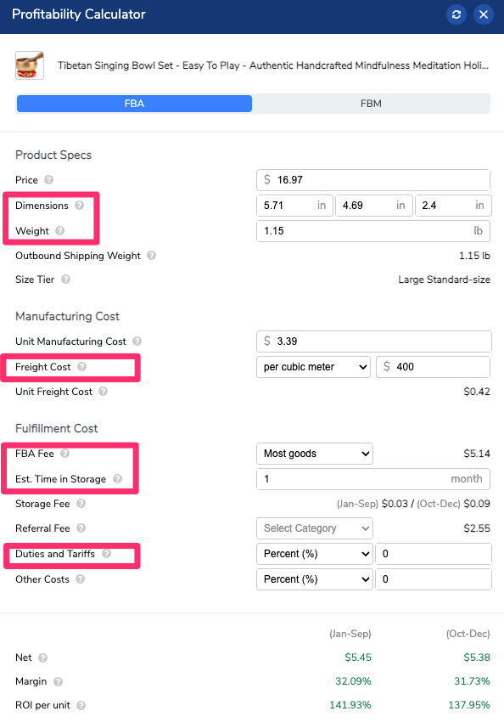
Product COGS = Unit Cost + Shipping ++
The logistics are built into your product COGS
COGS = Unit Cost + Shipping + Customs + Tariff + Inland Transport + warehousing + FBA Prepping + Ship to FBA
A product can become non profitable due to its logistics
Usually start and optimize logistics as you grow Your Freight Forwarder Can Help! Usually also serves as your Customs Agent.
עודד גיא | לוגיסטיקה וייצור

Slide 6
Inspection Services
ALWAYS USE INSPECTION!
Very accessible service (china)
Approx 120$ per inspector per day
They know the job
Find problems that will cost you a ton
Keep your supplier on the leash.
Use the report for more needs
Better understand your product
עידן כהן| לוגיסטיקה וייצור

Slide 7
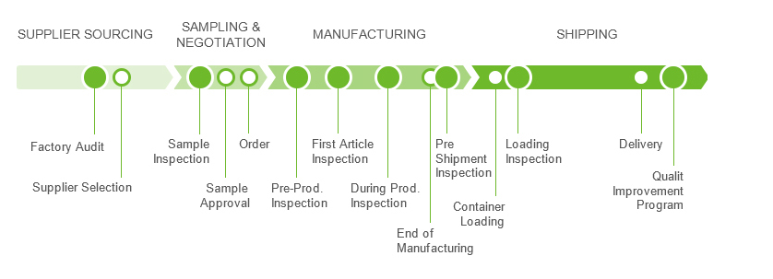
Inspection Services
Types and Uses
עידן כהן| לוגיסטיקה וייצור

Slide 8
Shipping and routing requirements Master Boxes - Pallets
Shipping and routing requirements
On this page
Box content information
Packaging shipments
Acceptable standard boxes:
Box dimensions
Box weight
Packing materials
Use these:
Do not use these:
Breaking down the material benefits
Additional requirements
Refused shipments
Shipping directly to a fulfillment center from a distributor
עידן כהן| לוגיסטיקה וייצור

Slide 9
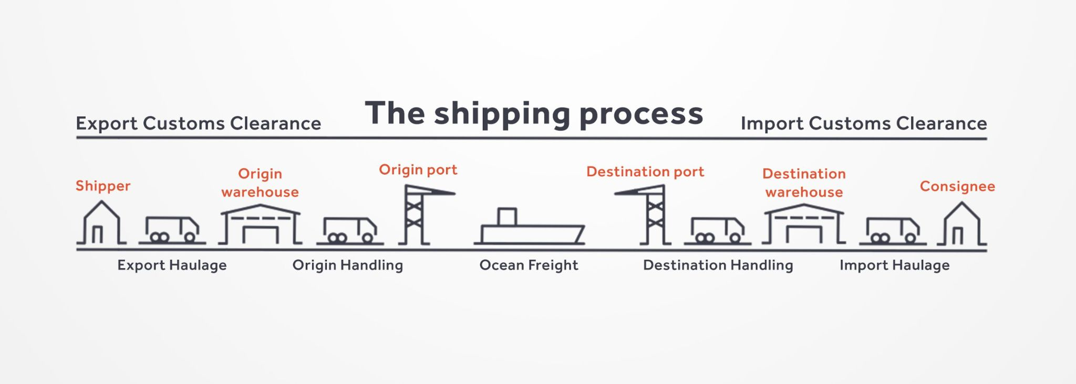
Freight Forwarding Origin to Destination
עידן כהן| לוגיסטיקה וייצור

Slide 10
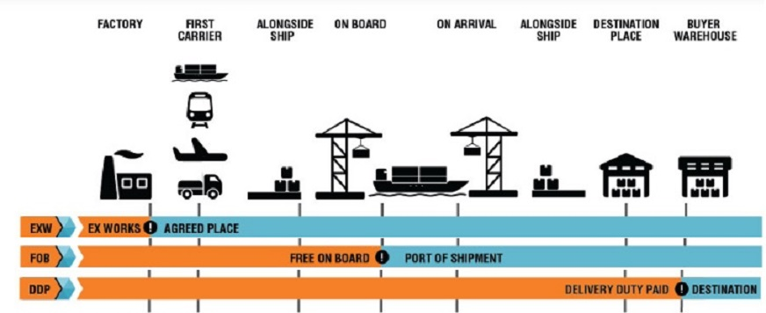
Freight Forwarding Incoterms (EXW, FOB, DDU, DDP)
עידן כהן| לוגיסטיקה וייצור

Slide 11
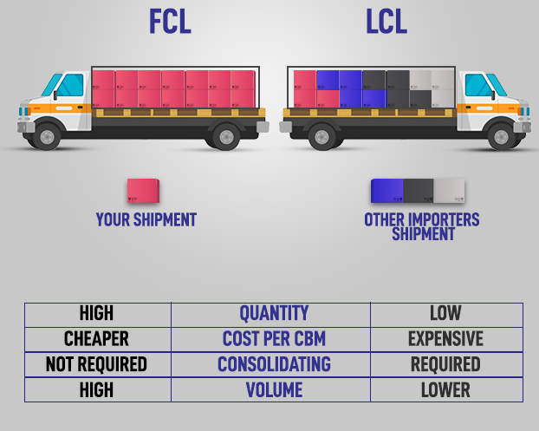
Freight Forwarding Air, Sea, Truck
By Air
Air Express (FEDEX, DHL…)
Air Freight
By Sea
FCL (Full Container Load) / LCL (Less Than Container Load)
Container types (20GP, 40ST, 40HQ)
Fast Boat (Matson)/ Slow Boat
Direct Delivery to FBA (consolidated) / Sea+Truck+palletizing
By Truck
Inland Transportation Into FBA
LTL (send pallets/Truck) / SPD (send as loose boxes)
LTL Is slower and cheaper/ SPD is faster and cost more
עידן כהן| לוגיסטיקה וייצור

Slide 12
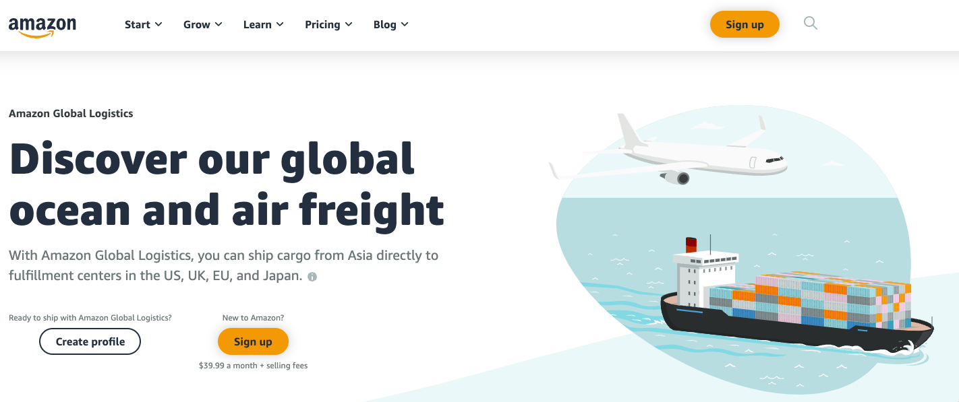
Freight Forwarding Amazon Global Logistics
עידן כהן| לוגיסטיקה וייצור

Slide 13
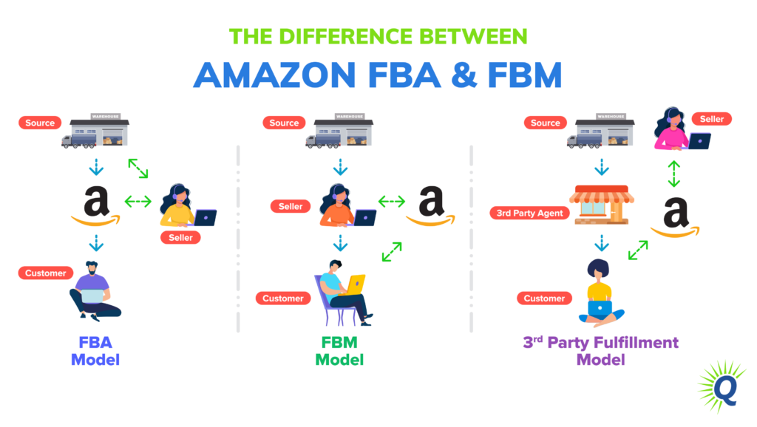
3PL Warehousing (outside FBA)
Inventory Storage models
עידן כהן| לוגיסטיקה וייצור

Slide 14
3PL Warehousing (outside FBA)
When Is this Needed
New Account With Limited inventory storage allowance (1000 units)
A per Asin unit limitation by amazon (300 per sku)
Shipping a large quantity from supplier - FCL
Maintaining inventory for selling on other channels (retail, shopify, walmart)
Use a 3pl as a Prep-Center for prepping and inspection prior to FBA
Using a 3PL warehouse for FBM fulfilment
עידן כהן| לוגיסטיקה וייצור

Slide 15
3PL Warehousing (outside FBA)
Principles & Guidelines
You want to know this option and be able to set it up quickly, or have it ready for when you need it urgently.
When you grow - you will have a 3pl warehouse eventually
Try to ship MOST of the selling inventory directly into FBA - it is cheaper and faster
Try to keep a 3PL on a low volume but with all the capabilities already available, integrated and tested in advance.
Use 3PL for safety buffer inventory and FBM
עידן כהן| לוגיסטיקה וייצור

Slide 16
Maintaining KPI's IPI Score
עידן כהן| לוגיסטיקה וייצור

Slide 17
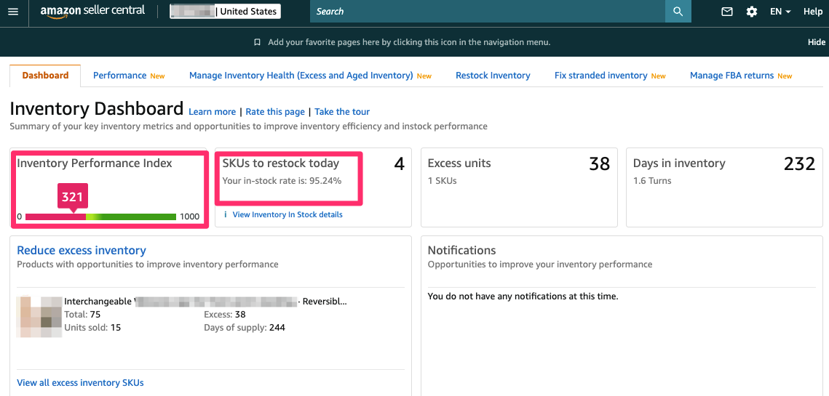
Maintaining KPI's Inventory Dashboard
עידן כהן| לוגיסטיקה וייצור

Slide 18
Supply Chain Tools & Resources
TOOLS
So Stocked (tool+content)
Helium10 Inventory Manager
Many other
Online Education
Inventory Dashboard (SC)
Restock Inventory (SC)
SERVICES
Local Freight Forwarders (He) Rosenthal Logistics Unicargo
Inspection Services (China)
Supply Chain Manager VA’s
עידן כהן| לוגיסטיקה וייצור

Slide 19
Keep Updated - Be Flexible
During Covid-19 Amazon experienced a booming demand.
FBA Centers Got packed, Global Supply Chain bottlenecks
Amazon Started applying limitations:
Prioritising ‘Essential Items’
A per SKU storage unit limitations
Account levels storage limits
Prioritising and delaying items on receiving
Refusing new shipping plan creations
FBA delivery allocations - different FBA centers / Split destinations
עידן כהן| לוגיסטיקה וייצור

Slide 20
Supply Chain Breakthroughs
During Covid-19 Amazon experienced a booming demand.
FBA Centers Got packed, Global Supply Chain bottlenecks
Amazon Started applying limitations:
Prioritising ‘Essential Items’
A per SKU storage unit limitations
Account levels storage limits
Prioritising and delaying items on receiving
Refusing new shipping plan creations
FBA delivery allocations - different FBA centers / Split destinations
עידן כהן| לוגיסטיקה וייצור

Slide 21
Thank You
www.negev-prime.com

