Slide 1
PPC
Fundamentals, Optimization and Strategy

Slide 2
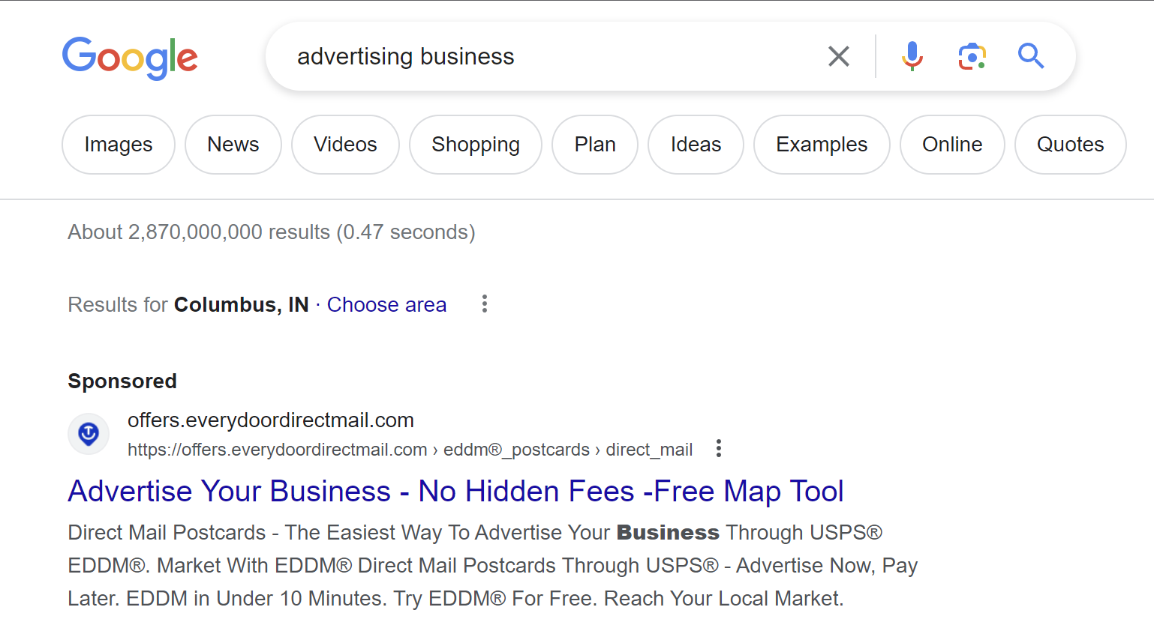
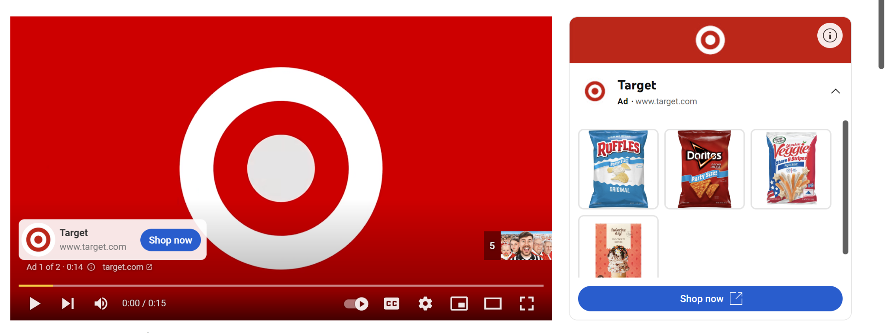
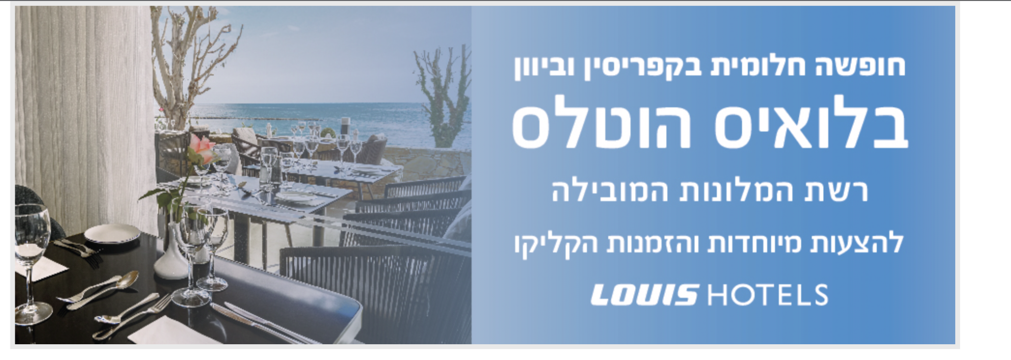
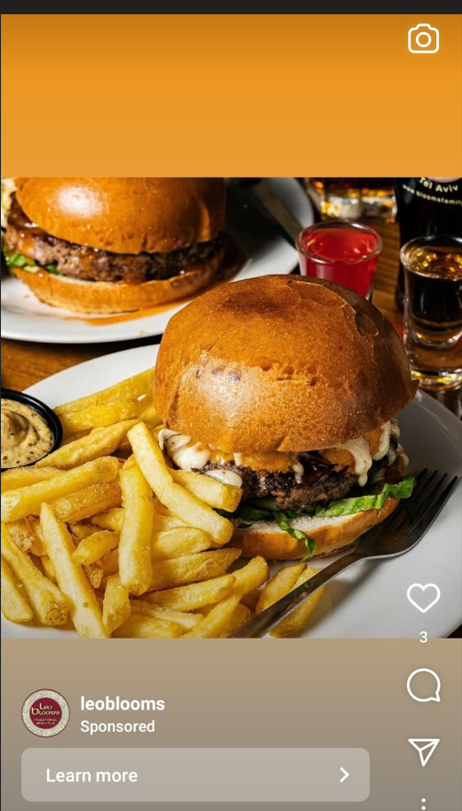
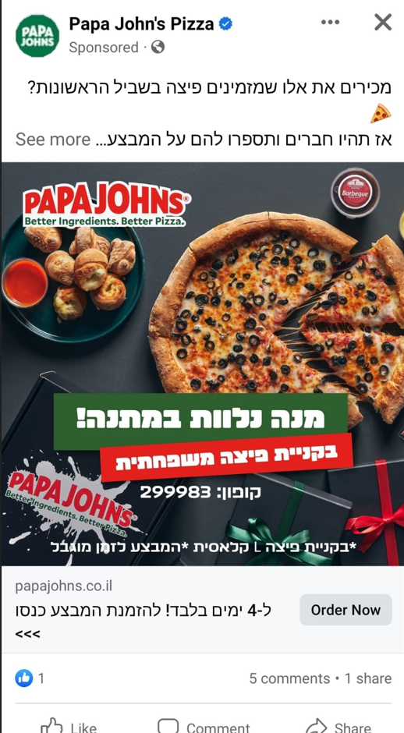
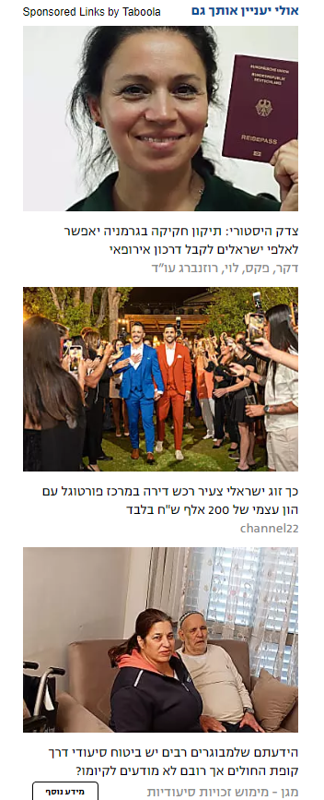
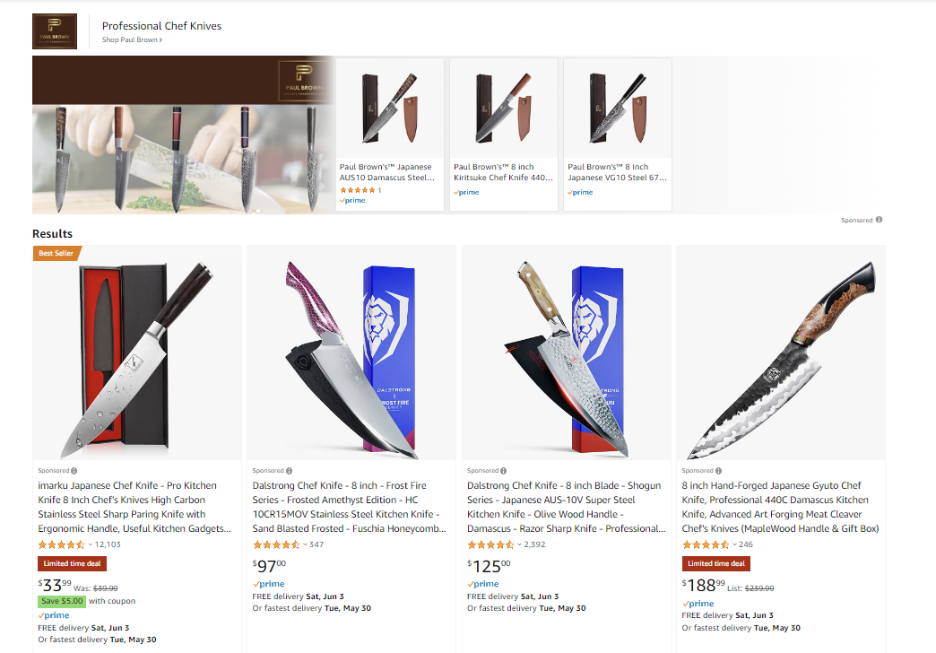
What is PPC?
Notes:
הסבר קצר על מה זה PPC

Slide 3
Why is PPC important in Amazon?
Bring traffic and sales to your product
Shows your product in better places then organic
Improves ranks
Competition
Buying Data
Pay to Play

Slide 4
How those it work? The auction
Target -> Keyword, Competitors, Auto, Category, Audience
Advertiser
Relevance
Bid
The Ad
Seller 1 | Low | 4$ | Not Showing
Seller 2 | High | 0.77$ | Showing First
Seller 3 | Mid | 1.33$ | Showing second

Slide 5
How do I get relevant in Amazon
KWs and Indexing
Price
Main photo
Category
Relevant KW

Slide 6
Types of Ads on Amazon
Sponsored Products
Sponsored Display
Sponsored Brand

Slide 7
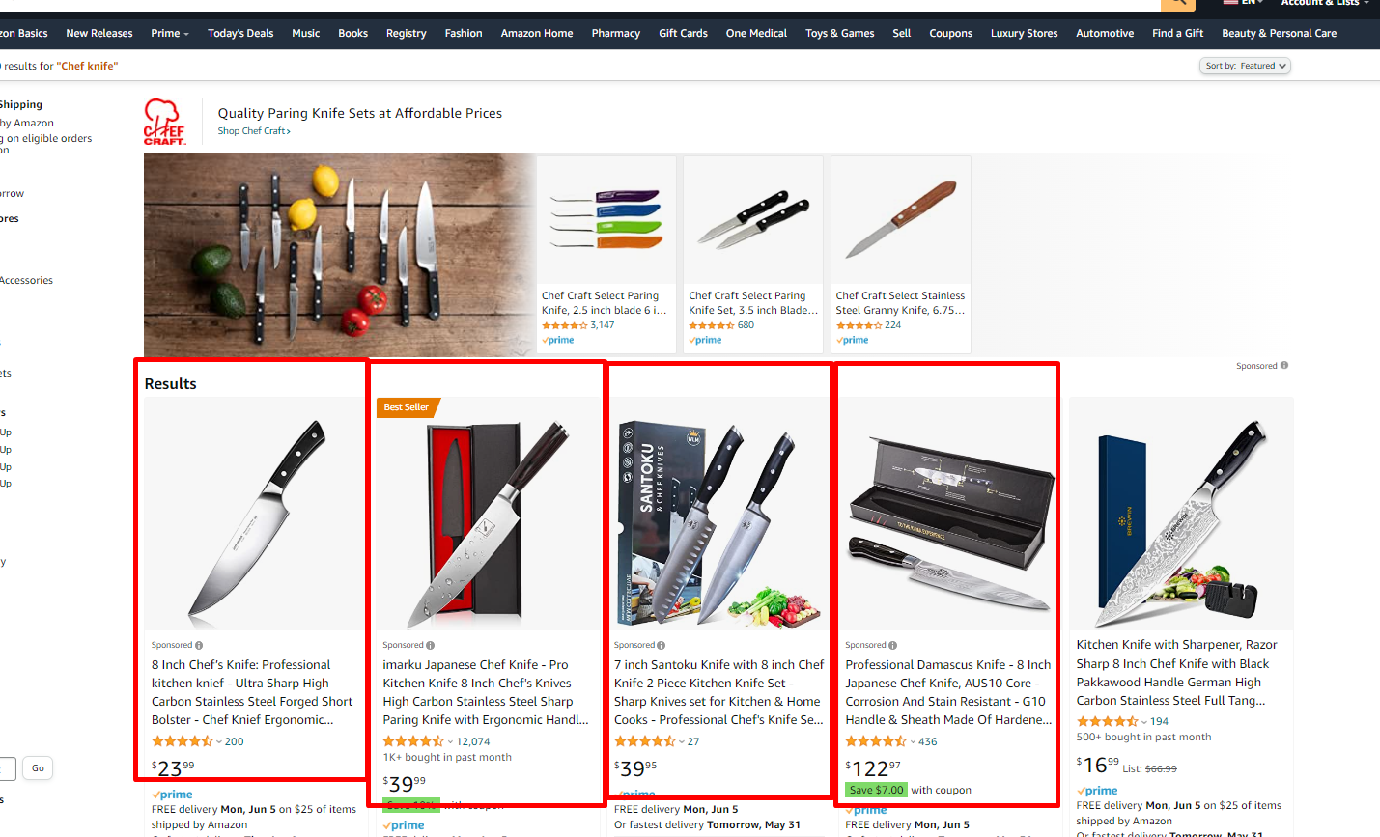
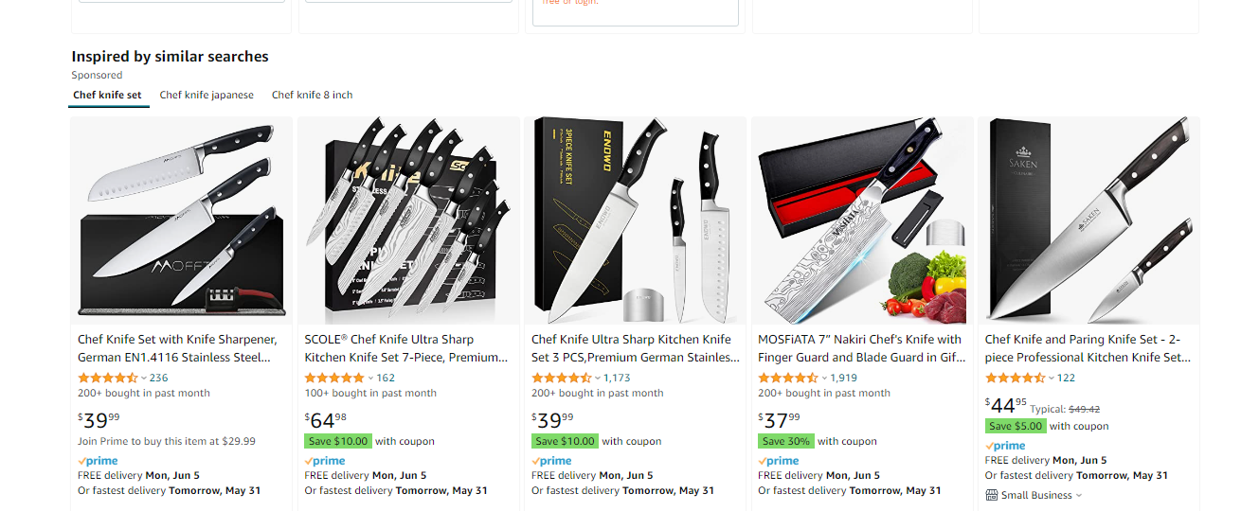
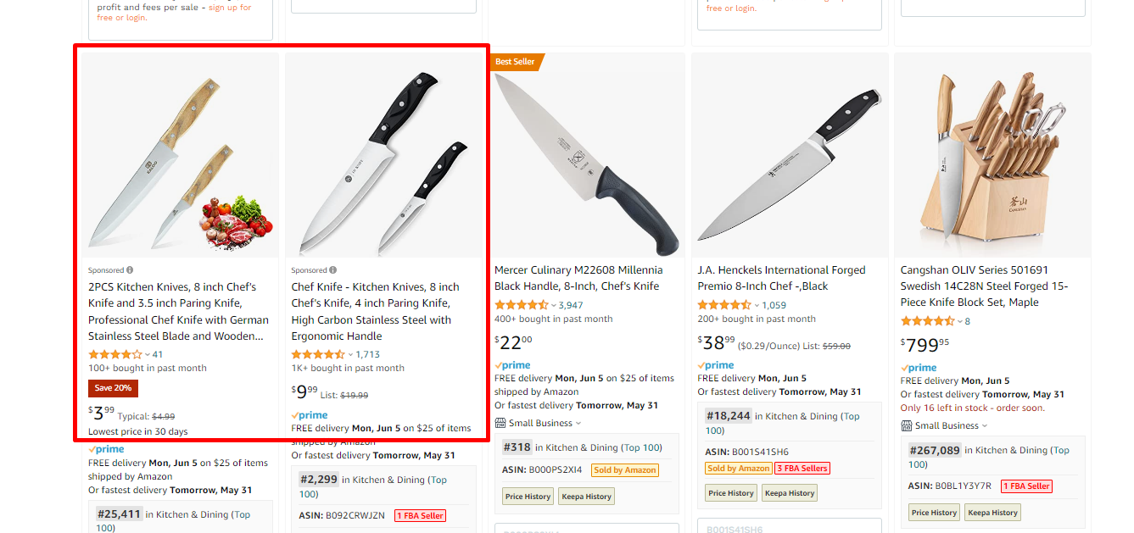
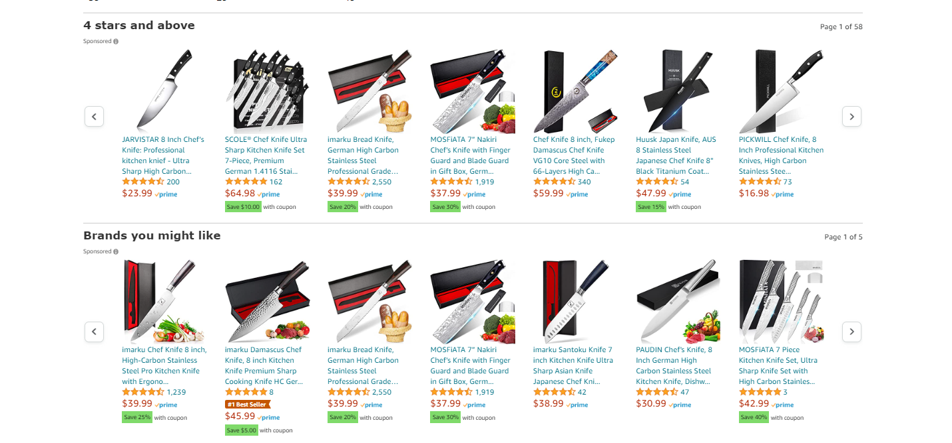
Sponsored Products

Slide 8
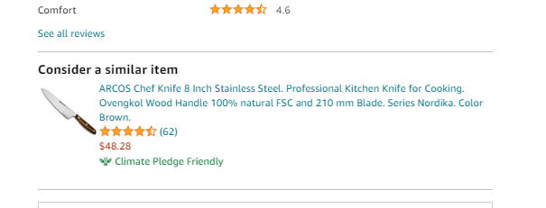
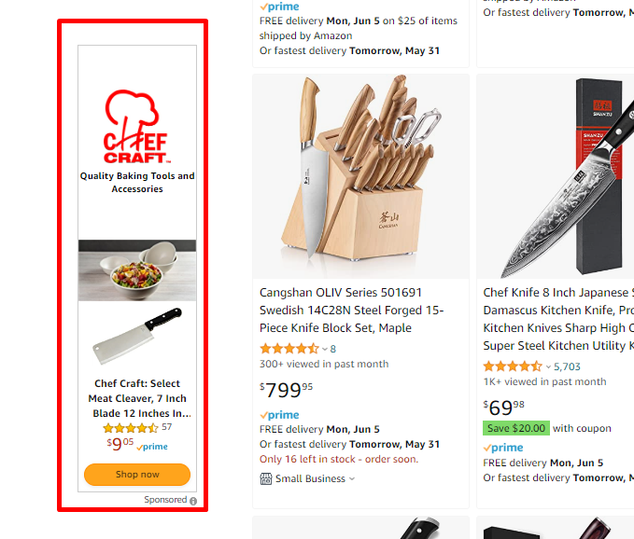
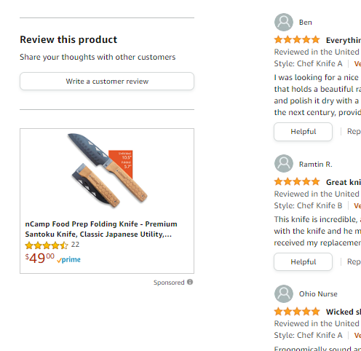
Sponsored Display

Slide 9
Sponsored Brands

Slide 10
How Campaigns are built?
Campaign -
Bidding strategy
Budget
Placements
Ad Group- Targeting
Bids
Ad Group-
Targeting
Bids
Ad Group- Targeting
Bids
Ad/product
Ad/product
Ad/product
Ad/product
Ad/product
Ad/product

Slide 11
Types of Campaigns on Amazon
Auto Campaign
Manual targeting
KW target (ad group level)
Product target (ad group level)
Headline (manual targeting)
Storespotlight (manual targeting)
Video (manual targeting)
Display video
Display ad

Slide 12
Targeting

Slide 13
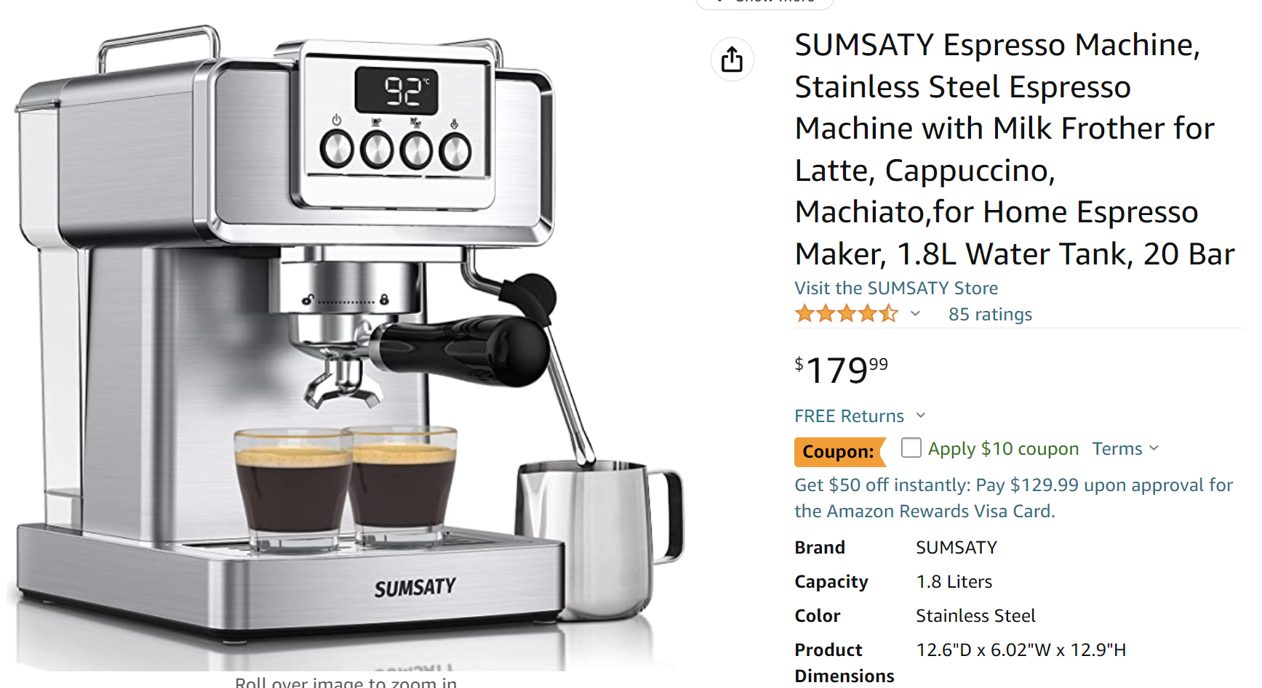
Targeting - Automated Campaigns - (Sponsored Products)
Close match -> coffee machine, coffee maker etc.
Loose match -> kitchen appliance, gift for dad, iphone case (rare but..)
Substitutes -> Other espresso machines and coffee makers
Complements -> coffee beans, machine cleaners, foam mug etc.

Slide 14
Targeting - KWs vs STs (SP + SB)
The KW -> espresso machine
The search terms
Broad -> machine for espresso coffee maker stainless
Phrase -> stainless steel espresso machine
Exact -> espresso machine or espresso machines
Exact doesn’t include er est ing
Make / Maker / making /
fine / finest

Slide 15
Targeting - Category & ASIN targeting (SP+SB+SD)
Product targeting is
NOT only for product pages!
Category targeting
Level 1 category - Semi-Automatic Espresso Machines
Level 2 term
If price is bigger smaller
If specific brands
If rating is more then X stars
ASIN targeting - AI see AI do
Exact -> specific product
Expended -> similar products as well
Notes:
לדבר על איפה המיקומים של המודעות פה יופיעו. טרגוט אסינים מופיע גם בטופ פייג’ וגם בעמודי מוצר וגם בשאר החיפוש חשוב להדגיש את זה

Slide 16
Targeting - Negative Targeting (SP+SB)
Negative Exact -> Don’t advertise specific ST
Negative Phrase -> Don’t advertise STs similar to regular phrase
Negative ASIN -> Don’t target that product

Slide 17
Targeting - Auto Audiences (Sponsored Display)
Similar to advertised products
Audience affiliations - lifestyle, interest, life events
Online Behaviour

Slide 18
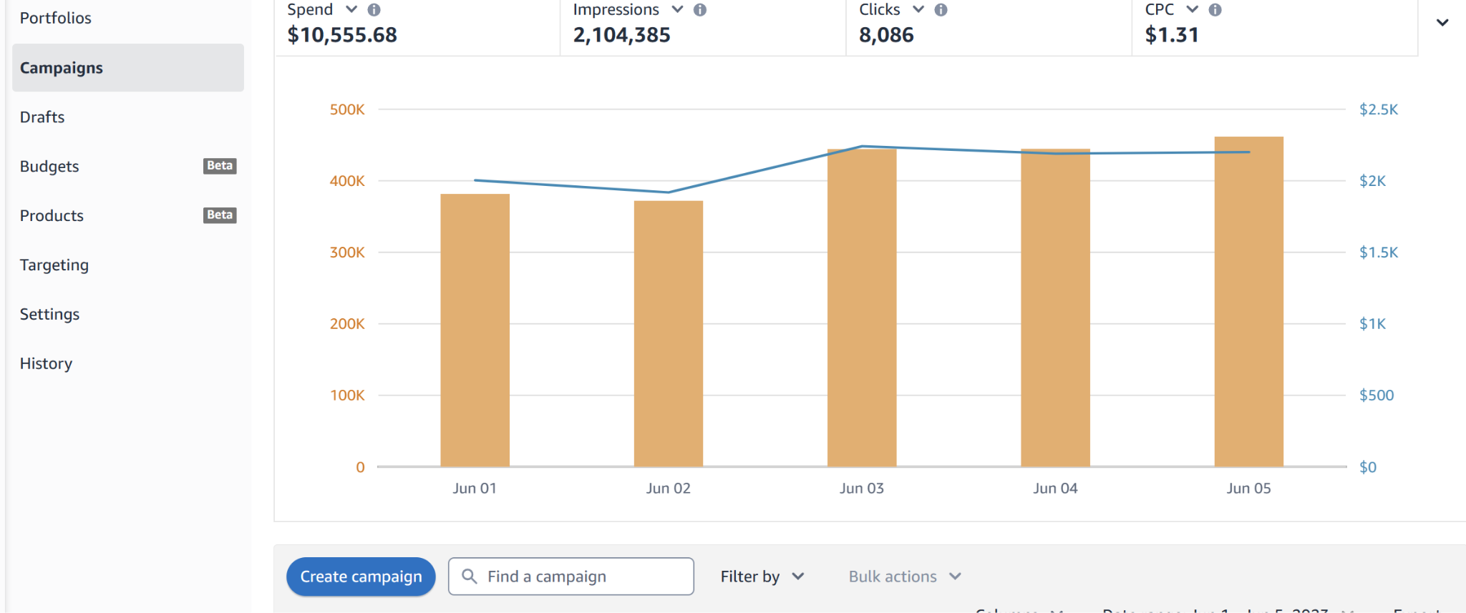
Advertising Console

Slide 20
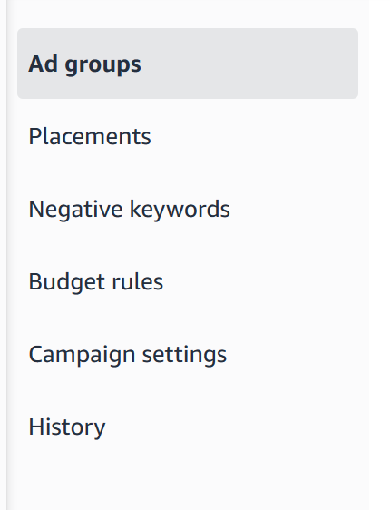
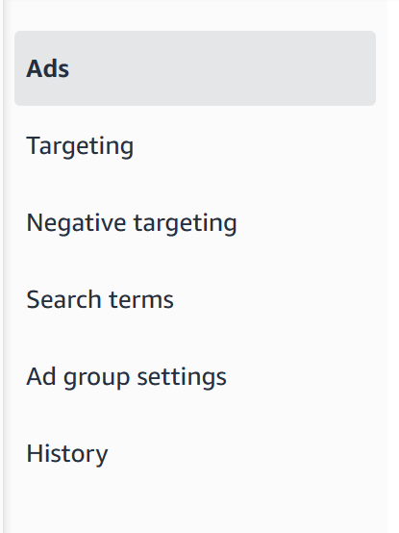

Slide 21
Basic parameters & KPIs

Slide 22
Impressions
Impressions = your ad is showing somewhere
Example:
Notes:
כל אחד מה 58 עמודים האלו מקבל אימפרשן!!
יש רק אינדקציה דרך הפלייסמנט מה החלוקה ואין דרך לדעת לפי ביטוי

Slide 23
Clicks = someone clicked on an ad
Orders = orders from the ad *Not units or specific product*
Sales = $ sum of all orders
Spent = total amount of $ spent
CPC = Spent/Clicks the average cost of a click

Slide 24
ACOS/ROAS - spent to sale ratio
TACOS - Spent to total revenue ratio
CPA - $ amount spent per unit
CTR = Clicks/Impression -> Indicator of relevance
Conversion Rate - Orders/Sales -> Relevance and list performance indicator

Slide 25
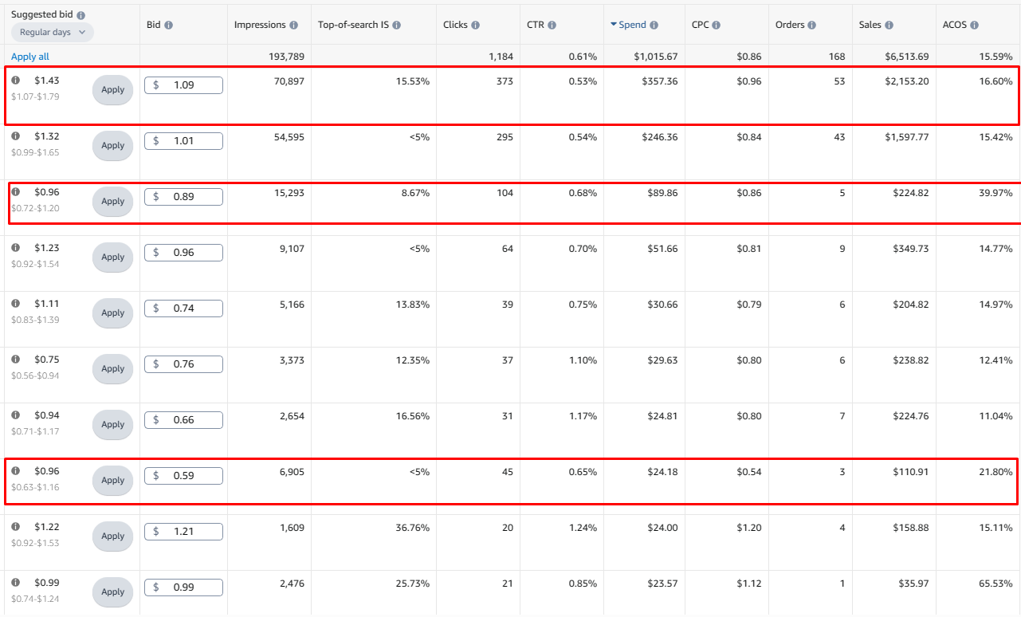
How do we use it?

Slide 26
Placements & Bidding

Slide 27
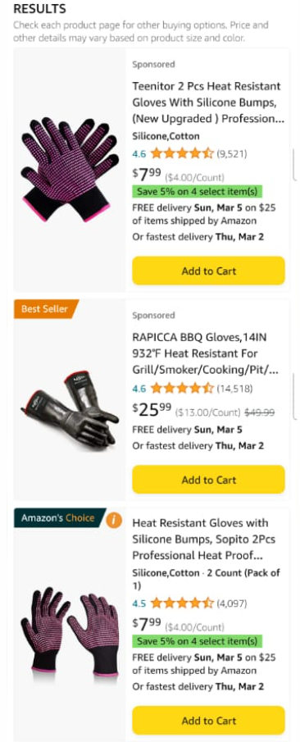
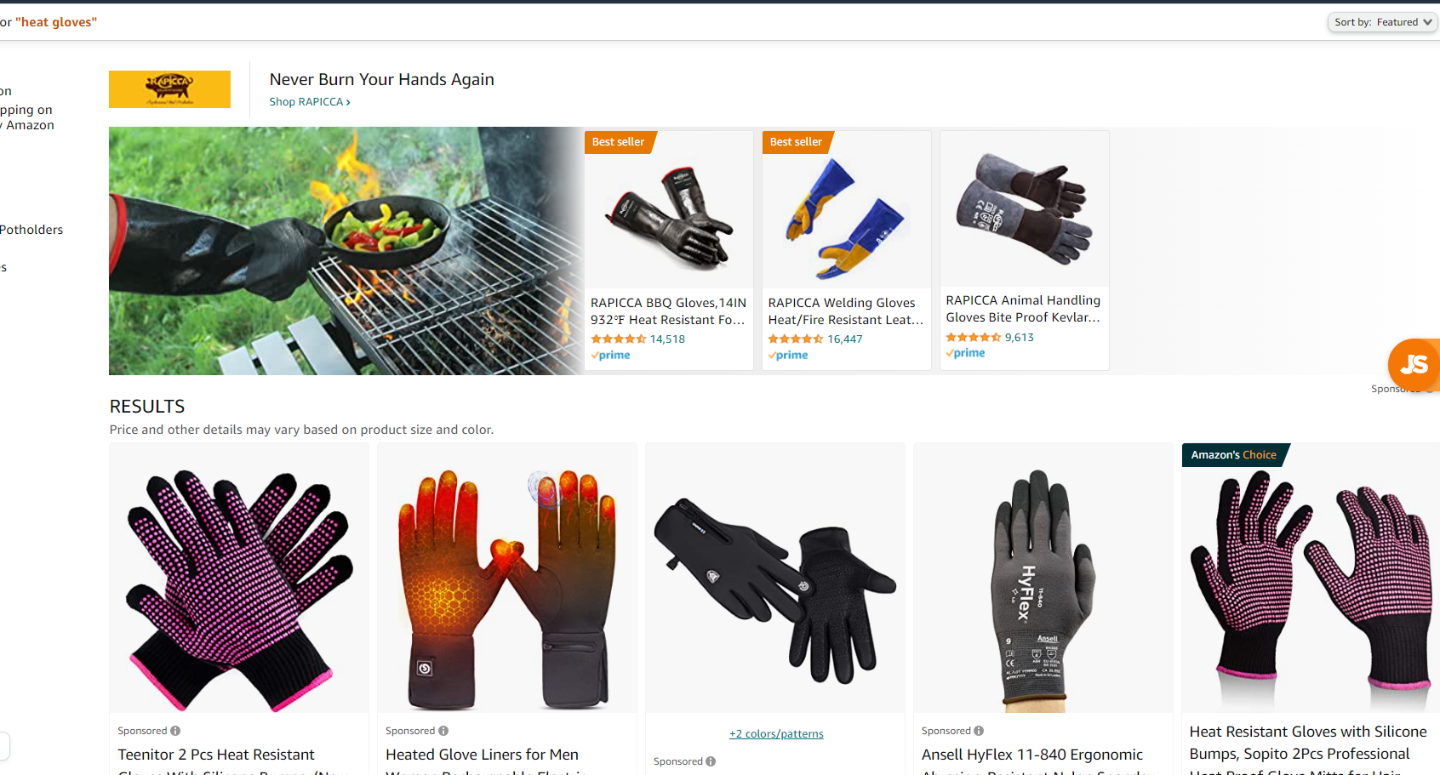
Where will my ads appear?
Top of search -> first 4 slots on Desktop OR first 2 slots on mobile
Notes:
משתנה בין קטגוריות אבל בגדול
להסביר מובייל ואיך מוצאים את זה

Slide 28
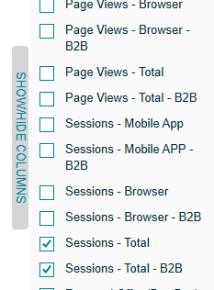
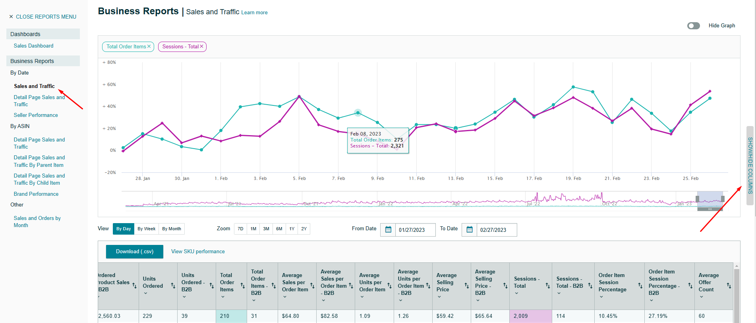
How much mobile is important? Check your sessions
Notes:
משתנה בין קטגוריות אבל בגדול
להסביר מובייל ואיך מוצאים את זה

Slide 29
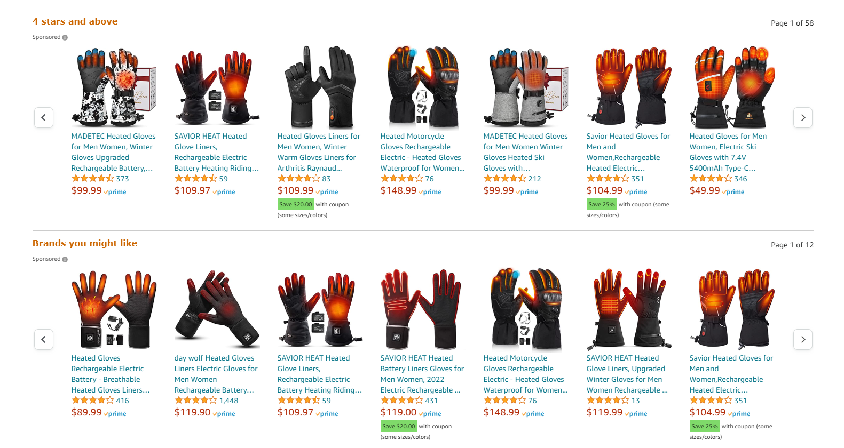
Where will my ads appear?
Product pages - > 4-6 slider lines below the list
Notes:
משתנה בין קטגוריות אבל בגדול

Slide 30
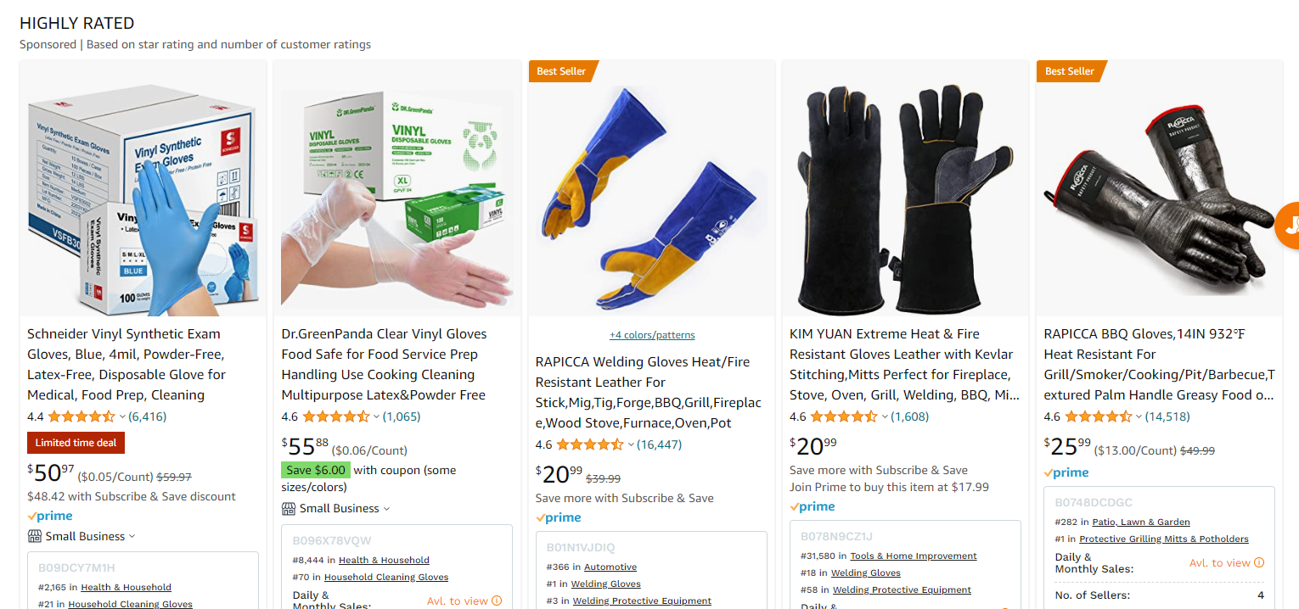
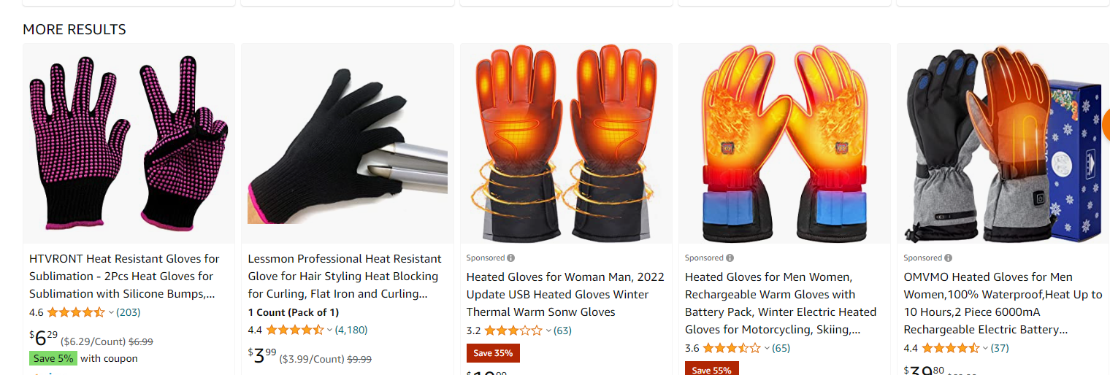
Where will my ads appear?
Rest of search -> everywhere else 2-3 more lines in a page
Notes:
משתנה בין קטגוריות אבל בגדול

Slide 31
Bidding
SAVE MONEY BE RELEVANT
The max you are willing to pay in an auction
Bid = your best offer per click
If your ad performed bad in the past = higher bid needed
If you bid on irrelevant KW = higher bid needed
If you are not indexed = higher bid needed
If you bid on a different category = higher bid needed
Notes:
חשוב להבהיר פה גם את הרצון של אמזון שהמודעה תהיה רלוונטית
אמזון רוצה שיקליקו אמזון רוצה שיקנו

Slide 32
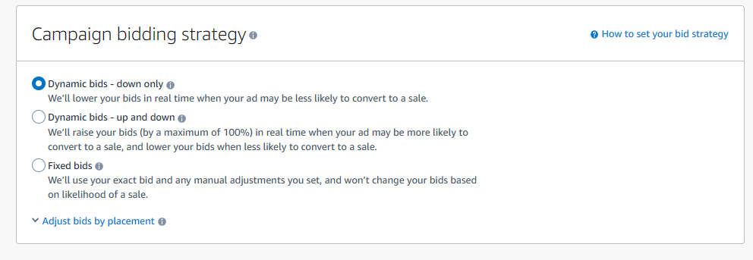
Bidding types on Amazon
Fix bid - what you put is what you get
Dynamic bid down - what you put or lower but… top of page * 1.5 product pages *1.25
Dynamic bid up of down - up to *2 on your bid if the AI think it will sale
Rule based - Target ROAS and let the AI work

Slide 33
Bidding types on Amazon
Fix bid - what you put is what you get
Dynamic bid down - what you put or lower but… top of page * 1.5 product pages *1.25
Dynamic bid up of down - up to *2 on your bid if the AI think it will sale
Rule based - Target ROAS and let the AI work

Slide 34
Placements
Allows you to change the % of bid for Placements
Placements are per campaign! Effect all ad groups
Notes:
להסביר פה על המנגנון
מקסימומים של אחוזים שאפשר לתת
איך עובדים איתו
מה אפשר ללמוד מזה
איך עושים אופטמיזציה לזה

Slide 35
Budgets and Launch Strategy

Slide 36
Budgets on Amazon
Budgets are weekly average of daily spent
Example your budget is 40$
Monday - Saturday spent is 35$
40*7=280$ but your current spent is 210$
Sunday spent 70$
Check daily spent in ration to budget
Check history for OOB campaigns
The more campaigns the more control BUT the more work.

Slide 37
PPC Launch Strategy
Gold campaign -> important KWs from KWs research
Auto campaign -> find out what works
Research campaign -> 2 ad groups phrase and broad to research KWs
Competitors campaign -> target relevant competitors

Slide 38
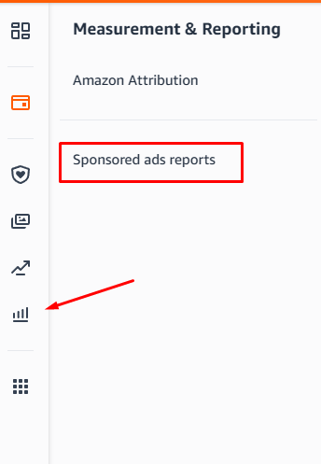
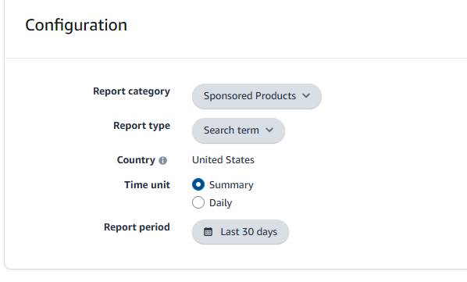
PPC is running what now?
WAIT!
Go over Search term Report
Go over competitors ASINs on targeting
Find new KWs
Get All the Data on what competitors work best
Optimize listing
Optimize Price
Discover trends
Find you BE ACOS
Optimize for profit

Slide 39
Optimization

Slide 40
Optimizations - in 3 levels
Search term report per campaign - garbage cleaning
Macro activities - Placements, bulk actions
Micro activities - Bids per target / turning on and off
Notes:
לדבר על איפה המיקומים של המודעות פה יופיעו. טרגוט אסינים מופיע גם בטופ פייג’ וגם בעמודי מוצר וגם בשאר החיפוש חשוב להדגיש את זה

Slide 41
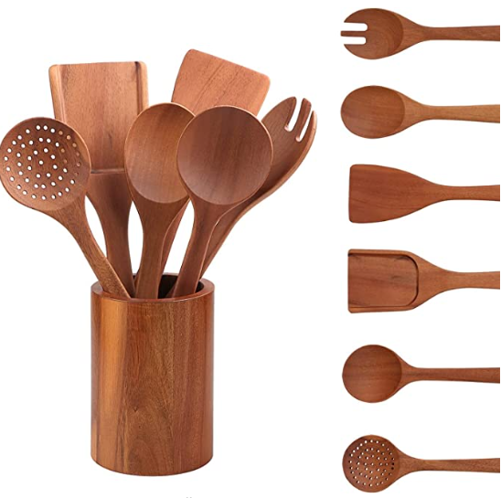
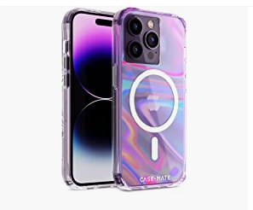
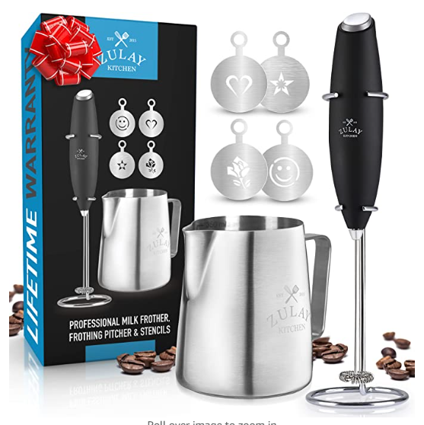
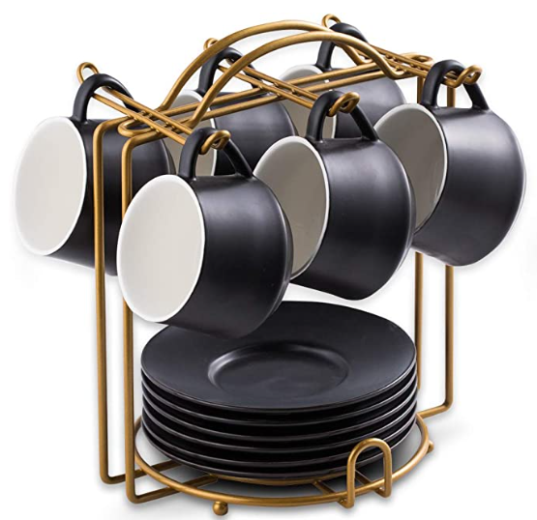
Garbage Cleaning
Auto campaigns, broad/phrase, category/expened ASIN
Part 1 Negative all irrelevant ASINs and KW
Kitchen washing solution
Chef knife
Gift for christmas
Coffee mug
Coffee set???
Notes:
להדגים איך בודקים אם רלוונטי דוגמא coffee set

Slide 42
Garbage Cleaning
Auto campaigns, broad/phrase, category/expened ASIN
Part 2 remove big spenders
1 orders out 9 clicks = 11% CONVR
Notes:
להסביר את הפילטרים בדוח שעושים
0 הזמנות
מעל X קליקים
ההיגיון של מספר הקליקים

Slide 43
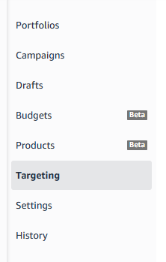
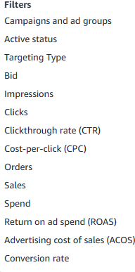
Macro Actions
All Campaigns - once a month +-
Look through period 30-65 days
Decrease at least by 10% for effect
Filter to decrease:
Above X clicks but + no sale
High spent + High CPC + High ACOS
High spent + low CPC (lots of clicks)
High ACOS + Lots of sales
High ACOS + Low sales + low CONVR
High CTR + low CONVR
Notes:
להסביר את הפילטרים בדוח שעושים
0 הזמנות
מעל X קליקים
ההיגיון של מספר הקליקים

Slide 44
Macro Actions
All Campaigns - once a month +-
Look through period 30-65 days
Increase between 10%-20% for effect
Filter to increase:
High CONVR + High CTR + Low ACOS
Low imp + Low clicks + above 2 orders
Low ACOS + high CONVR
Notes:
להסביר את הפילטרים בדוח שעושים
0 הזמנות
מעל X קליקים
ההיגיון של מספר הקליקים

Slide 45
Macro actions - Placements
Notes:
מה לומדים מזה
איך עושים אופטמיזציה

Slide 46
Micro Actions
When?
When a campaign shows bad performance
When strategic action is required
How?
One targeting at a time
Comparing time periods
Checking history of changes
Defining a test period
Notes:
להסביר דברים פה דינמים ביטוי יכול לא לעבוד בגלל תקופה
בגלל שינויים בפרסום של מתחרים
דוגמא משהו מעלה ביד
דוגמא משהו מפסיק פרסום

Slide 47
Micro Actions - Example
8 Feb - 18 Feb
18 Feb - 28 Feb
Notes:
הביטוי הראשון כדוגמא
ביצועים מעולים חרא של עליות
גונב תקציב משאר הקמפיין
היסטורית בדקתי לא נגעו בו תקופה מאוד ארוכה של כמה חודשים
Top of search IS ומה הוא אומר

Slide 48
Micro Actions
When do we turn a targeting off?
Doesn’t performed after multiple experiments
Doesn’t performed for a long period (thumb rule more than 40 days)
Has high imp but no clicks and high bid

Slide 49
Thank you!

